Slide 1


Active Transportation Program Grant:
73rd Avenue Active Routes to Transit
City of Oakland
Department of Transportation

Slide 2
Today’s Goals
ATP Program
Background
Design Concepts
Timeline
Questions/comments

Slide 3
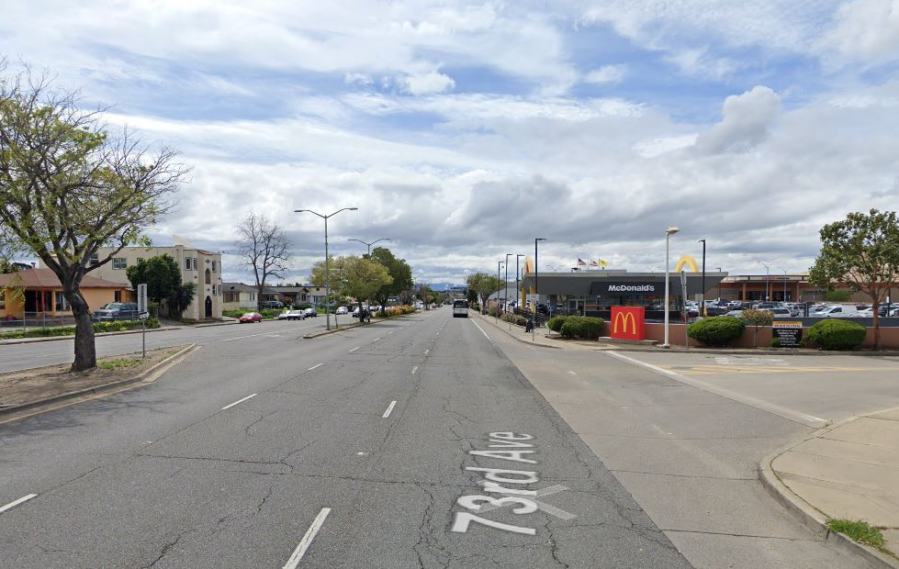
Active Transportation Program (ATP) Grant
The purpose of the ATP is to encourage an increased use of active modes of transportation, such as biking and walking by achieving the following goals:
Increase the proportion of trips accomplished by biking and walking.
Increase the safety and mobility of non-motorized users.
Advance the active transportation efforts of regional agencies to achieve greenhouse gas reduction.
Enhance public health
Ensure that disadvantaged communities fully share in the benefits of the program.
Provide a broad spectrum of projects to benefit many types of active transportation users.
73rd – Eastmont Transit Center
https://dot.ca.gov/programs/local-assistance/fed-and-state-programs/active-transportation-program

Slide 4
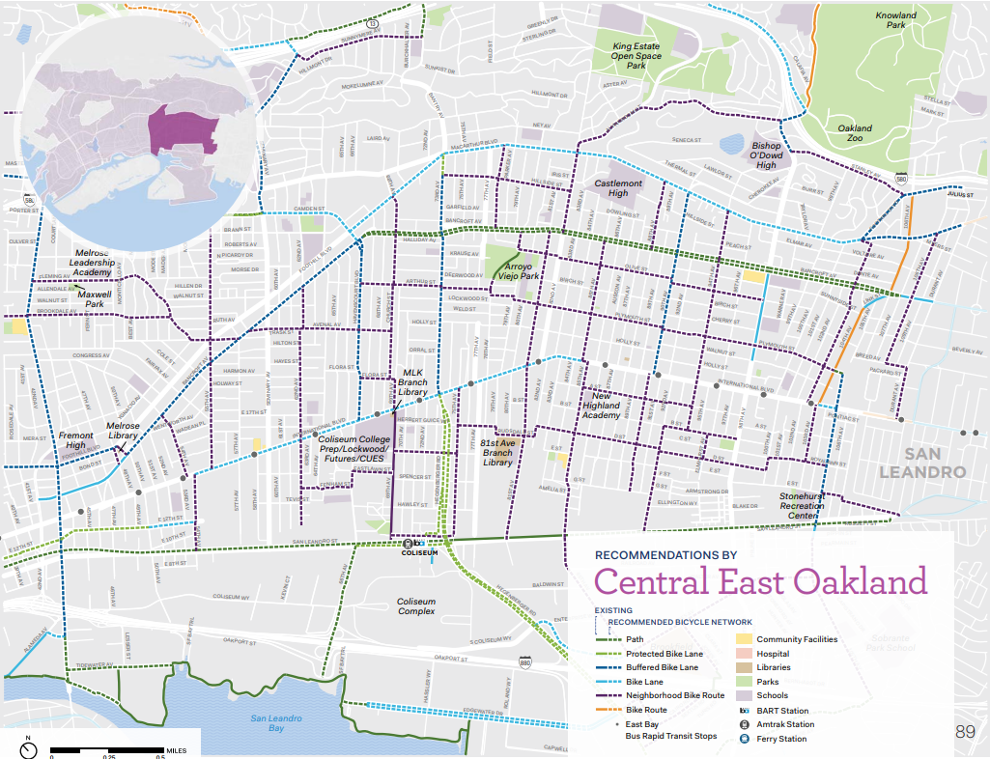
Background on 73rd Active Routes to Transit
The project was identified as a priority project in the 2019 bicycle plan update “Let’s Bike Oakland” and the 2021 East Oakland Mobility Action Plan (EOMAP). The City developed a resident and community-based organization-led design process to ensure that final recommendations resonated with the community.
We heard:
Safety concerns regarding speeding and bad driving behavior at intersections,
Security concerns biking and walking next to vehicle traffic due to potential exposure to drive-by assault.
Community members shared that they did not feel safe using the current bike facilities or crossing 73rd Ave to access the Eastmont Transit Center.

Slide 5
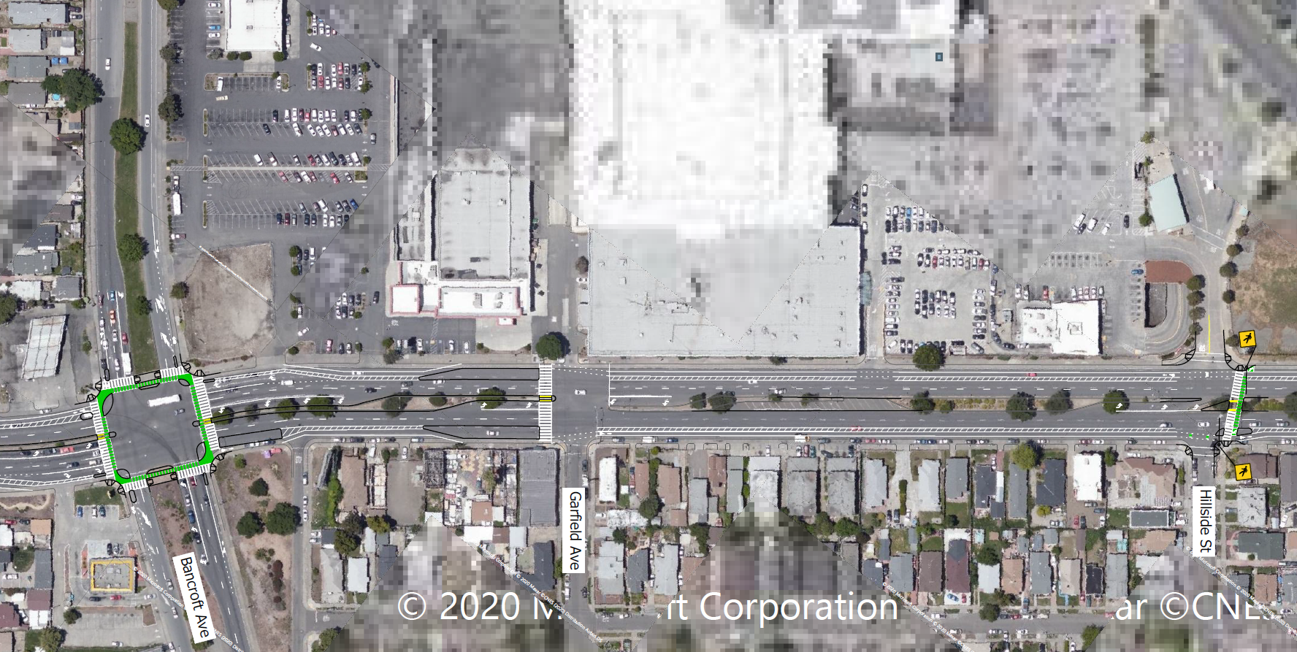
Design Concepts
Project Extent: Eastmont Transit Center to Coliseum BART
Buffered bicycle lanes, closing a gap in the network and creating more separation from motorized vehicles
Bus boarding islands to improve bus operations and give transit riders more visibility
Two protected intersections for bicyclists and to help shorten pedestrian crossings
High-visibility crosswalk markings at all intersections
Extended medians to provide a pedestrian refuge in center of street and to reduce turning speeds
Dedicated bicycle connection to Coliseum BART at International Blvd
A new pedestrian/bicycle crossing across 73rd to provide direct access to Eastmont Transit village

Slide 6
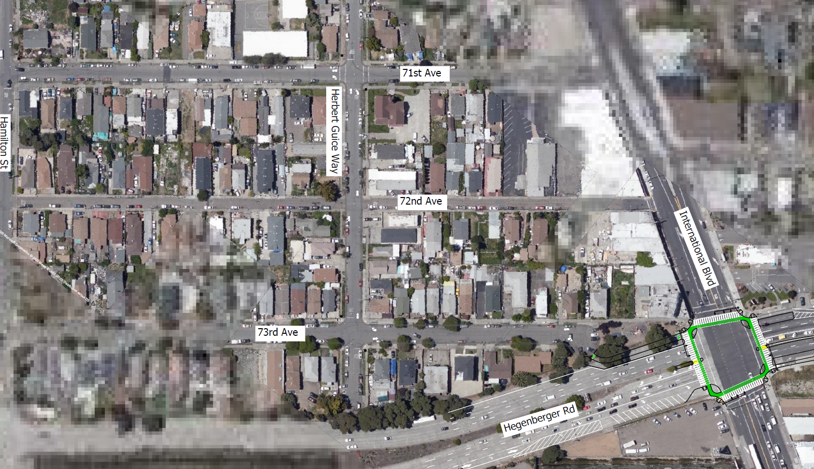
Timeline
East 15th St at 5th Ave
Active Transportation Program Cycle 6 Application Development
  April/May 2022
ATP Cycle 6 Application Due
  June 15, 2022
ATP Cycle 6 Award Notification
  December 2022
Project Start Date (if awarded)
  March 2023
Project Construction Complete (if awarded)
  March 2030
After (Rendering)
Notes:
project start date:
When we can go into bid for consultants to do the design work (about 18 months for design)
Then project construct bid and award (6 to 12 months)
Actual construction about another 24 months

Slide 7
Any questions or comments?
Thank you!
Manuel Corona, OakDOT
mcorona@Oaklandca.gov
https://www.oaklandca.gov/projects/73rd-avenue-active-routes-to-transit

