Slide 1
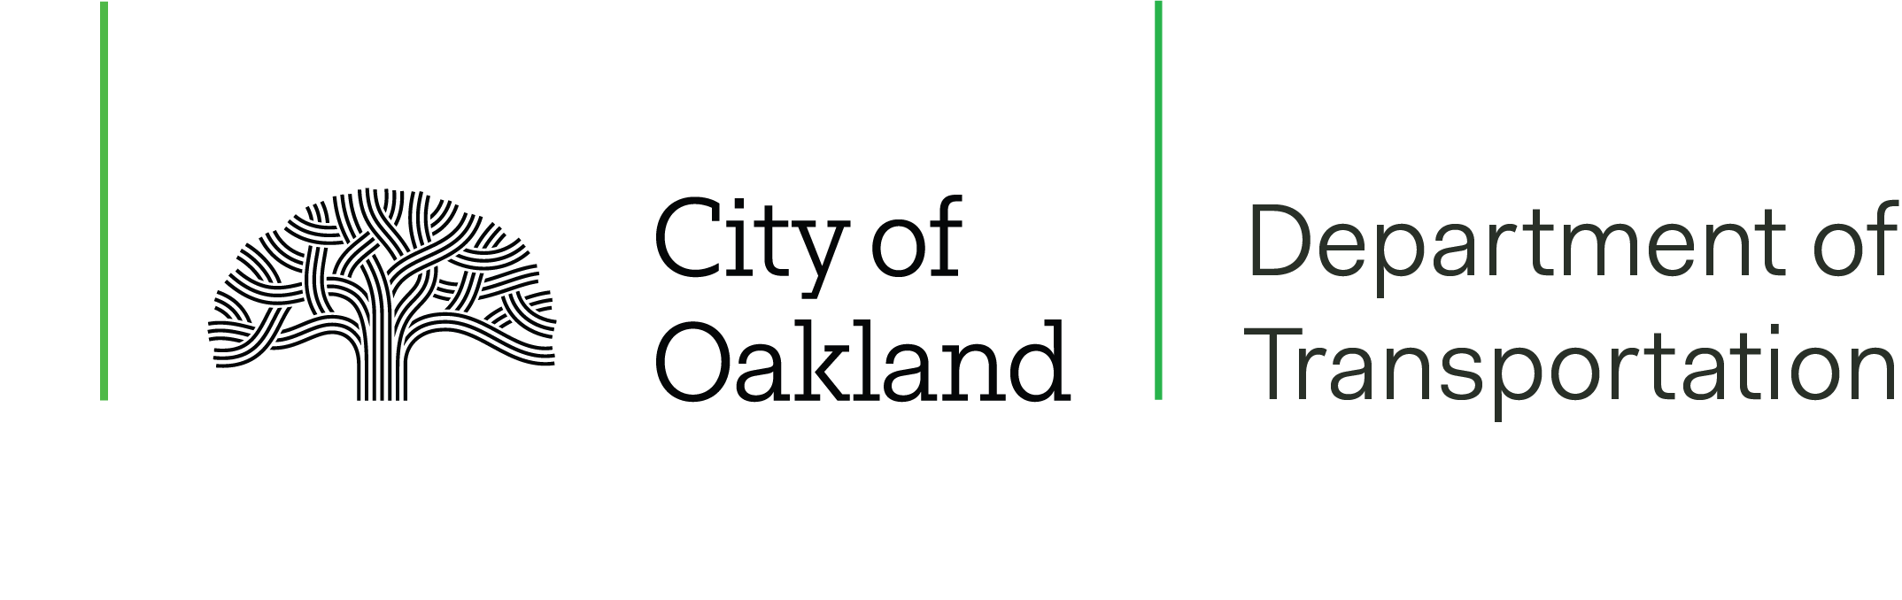
73rd Avenue
Active Routes to Transit
Mayor’s Commission on
Persons with Disabilities
May 20, 2024
Manuel Corona
Jane Mei
ppd@oaklandca.gov
Planning & Project Development
OakDOT

Slide 2
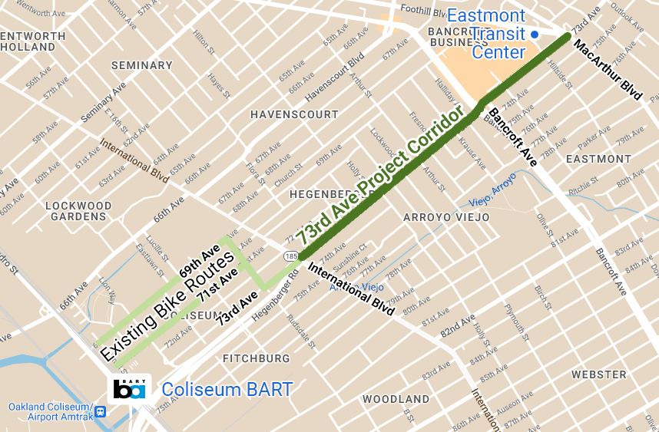
Project Overview
Project extents: 73rd Ave from MacArthur Blvd to International Blvd
Connects to:
  Eastmont Transit Center
  Eastmont Town Center (shopping mall)
  AC Transit Bus Rapid Transit (Route T1 Tempo)
  Coliseum BART Station
  (via existing bike routes)
  Image: A map highlighting the
  73rd Ave Project Corridor.

Slide 3
Project Overview
Goal: Prioritize safety and comfort for transit users, pedestrians and cyclists.
Current status: OakDOT has selected a preferred design alternative and is applying for grant funding.
Project website: https://bit.ly/73rdActive
  Image: A map highlighting the
  73rd Ave Project Corridor.

Slide 4
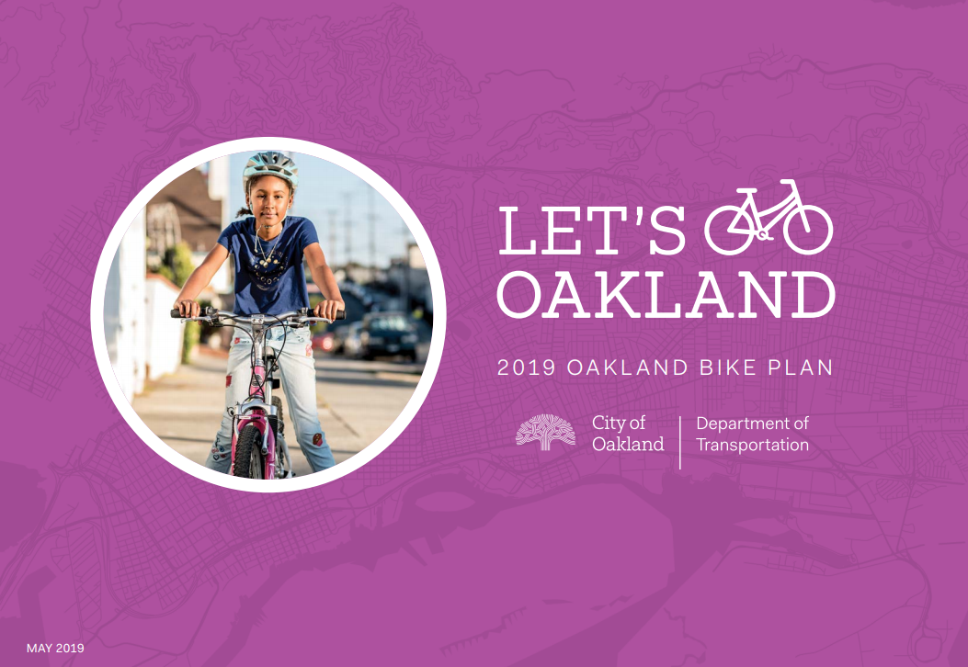
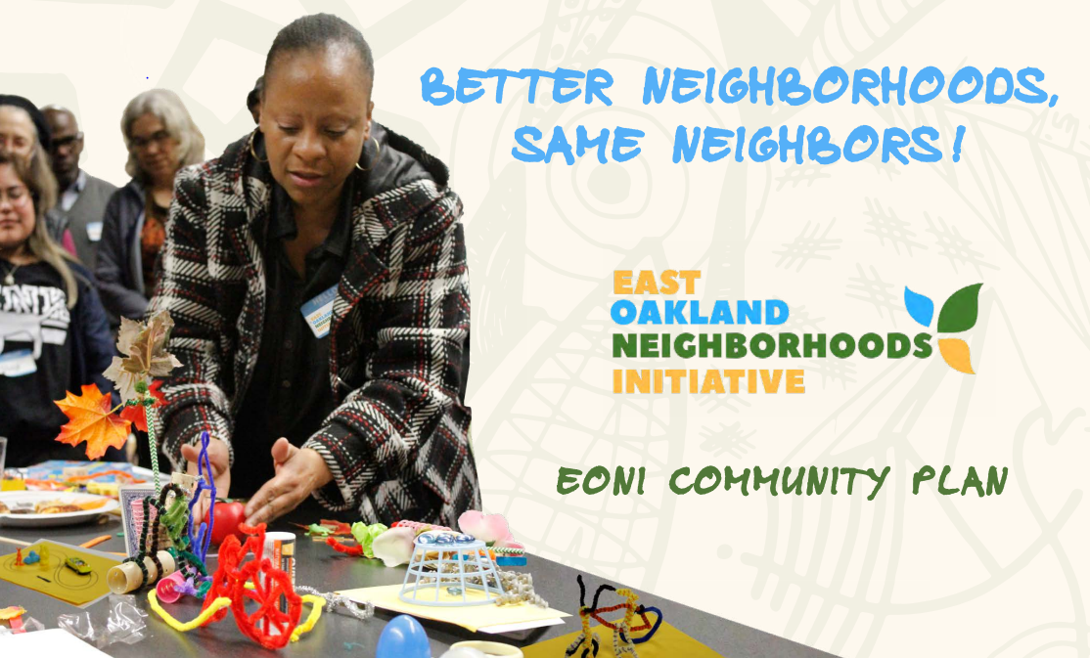
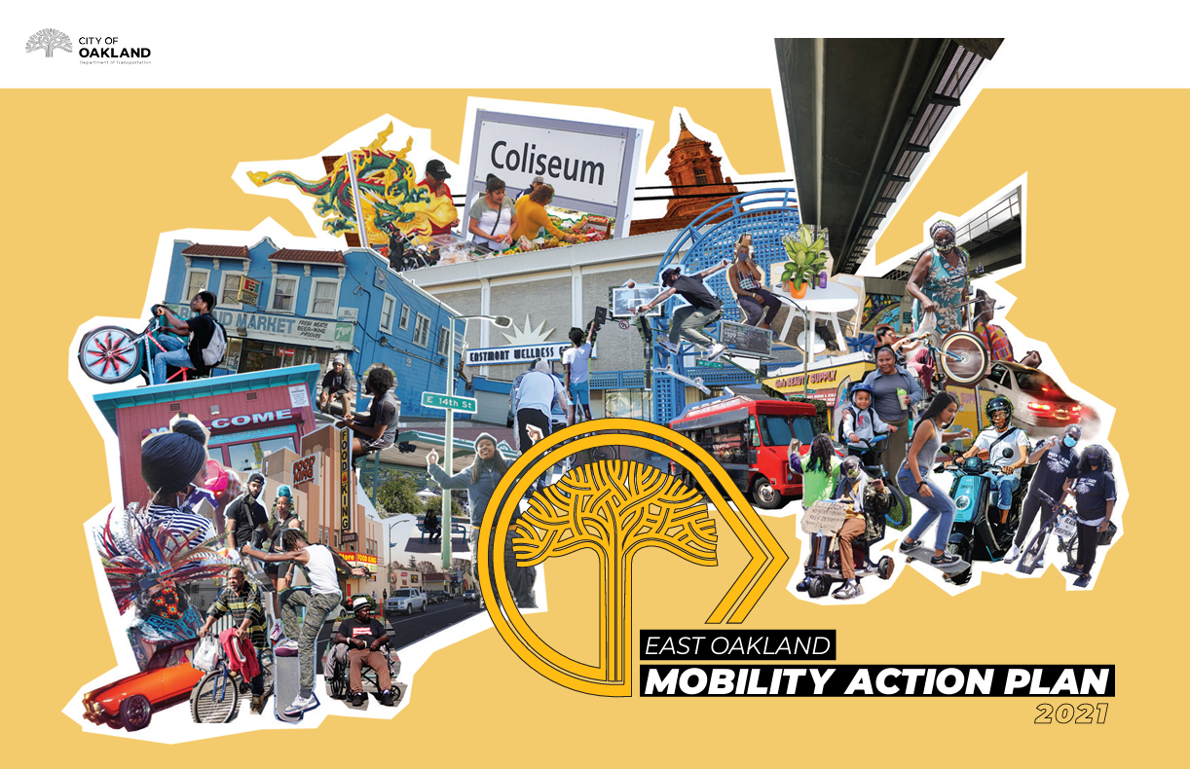
Past Planning Efforts
Let’s Bike Oakland Oakland Bike Plan Update (2019)
East Oakland Neighborhoods Initiative (2019)
East Oakland Mobility Action Plan (2021)
These plans identified 73rd Ave as a priority in East Oakland. Community members were concerned about speeding, bad driving behavior, crossing streets, and walking or biking next to traffic.

Slide 5
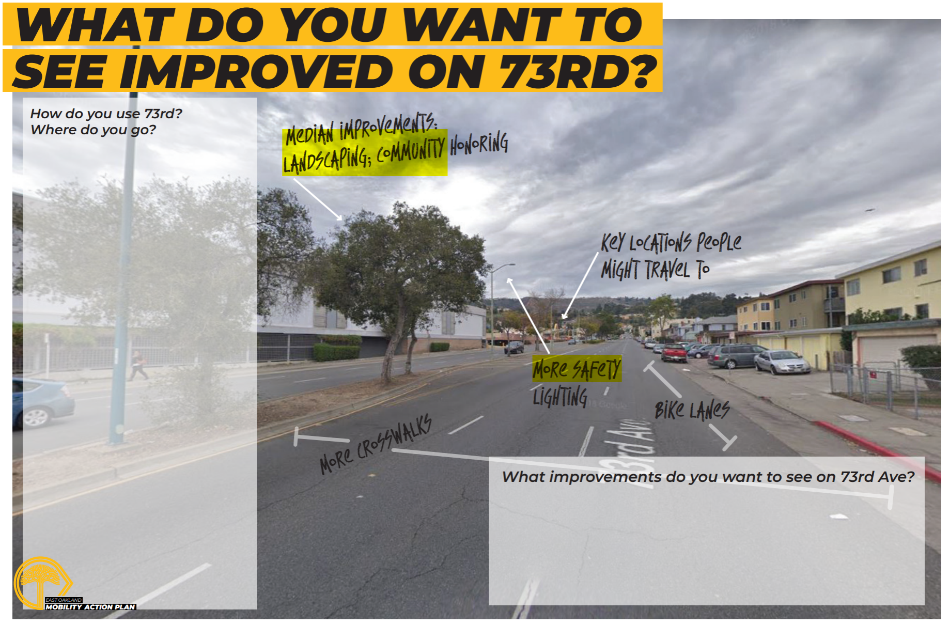
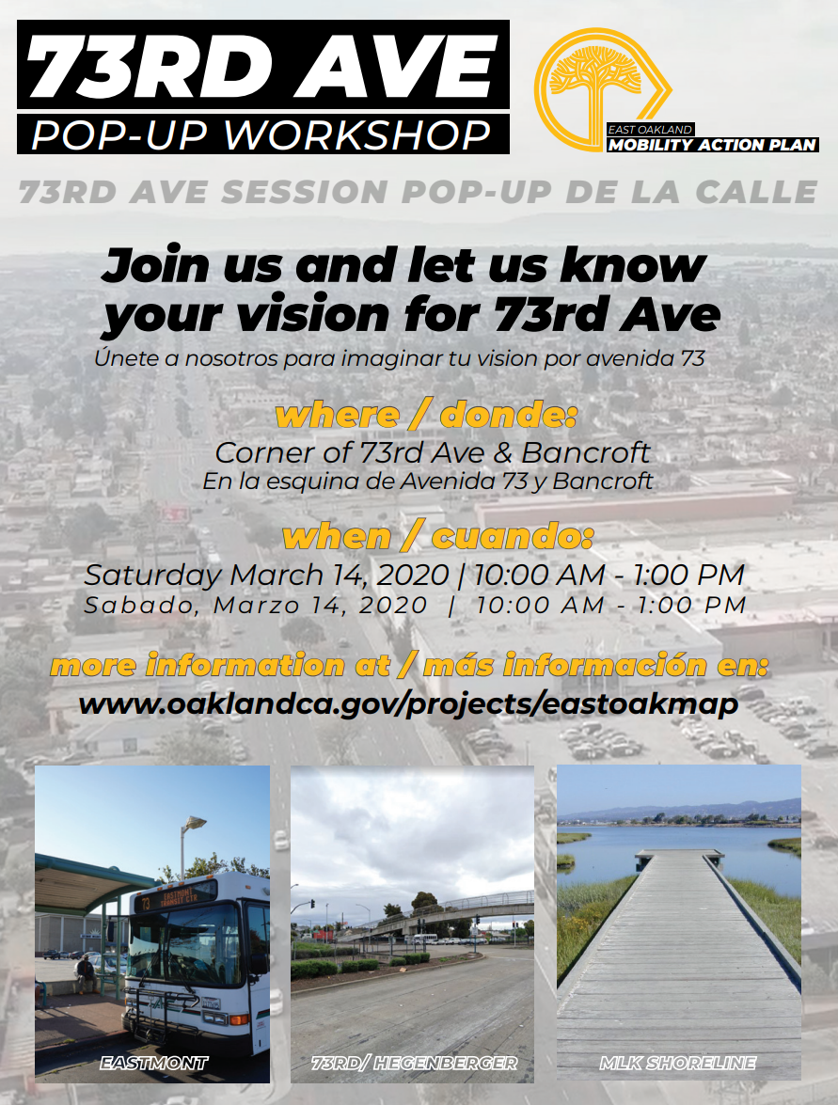
Past Funding Application
In 2022, OakDOT applied but was not awarded for Cycle 6 of the Caltrans Active Transportation Program grant (ATP).
The application included designs for buffered bike lanes, which received low scores because there were not enough safety improvements.
  Image: Flyers from the East Oakland Mobility Action Plan in 2021.

Slide 6
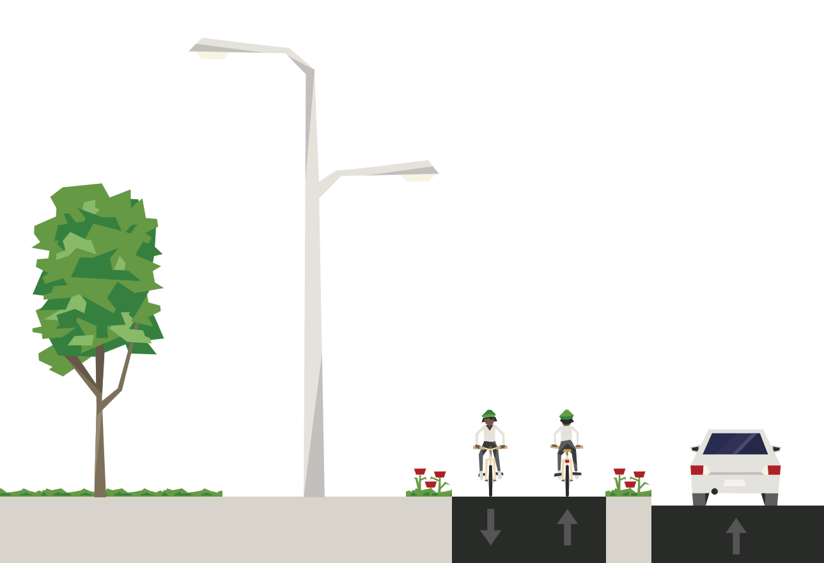
Current Grant Application
In June of 2024, OakDOT will apply for Cycle 7 of the Caltrans Active Transportation Program (ATP) grant with new designs.
The application will include a design for a mixed-use path in the median, which was selected by community members.
  Image: Part of a cross-section showing bicyclists on a median path.

Slide 7
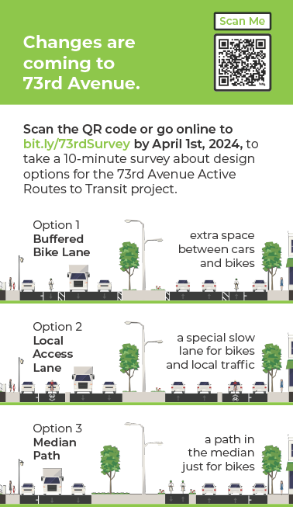
Design Selection Process
OakDOT spoke at community meetings, visited residents and businesses door-to-door, met with schools and other agencies, and distributed an online survey.
Community members, focusing on nearby residents, selected between three options:
Buffered Bike Lane
Local Access Lane
Median Path
  Image: A flyer asking 73rd Ave residents to take a survey online.

Slide 8
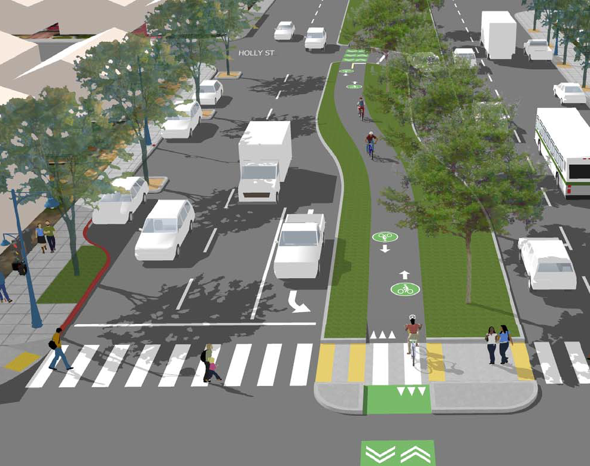
Selected Design: Median Path
Design Elements:
  Widened median from 18 ft to 42 ft
  Mixed-use path in the median
  Narrower 11 ft travel lanes
  Remove existing bike lanes
  Protected intersections at
  Bancroft Ave and International Blvd
  Curb extensions for shorter crossing
  Bus boarding areas
Cost: $35 million
(design and construction)
  Image: Rendering of the
  Median Path design option.

Slide 9
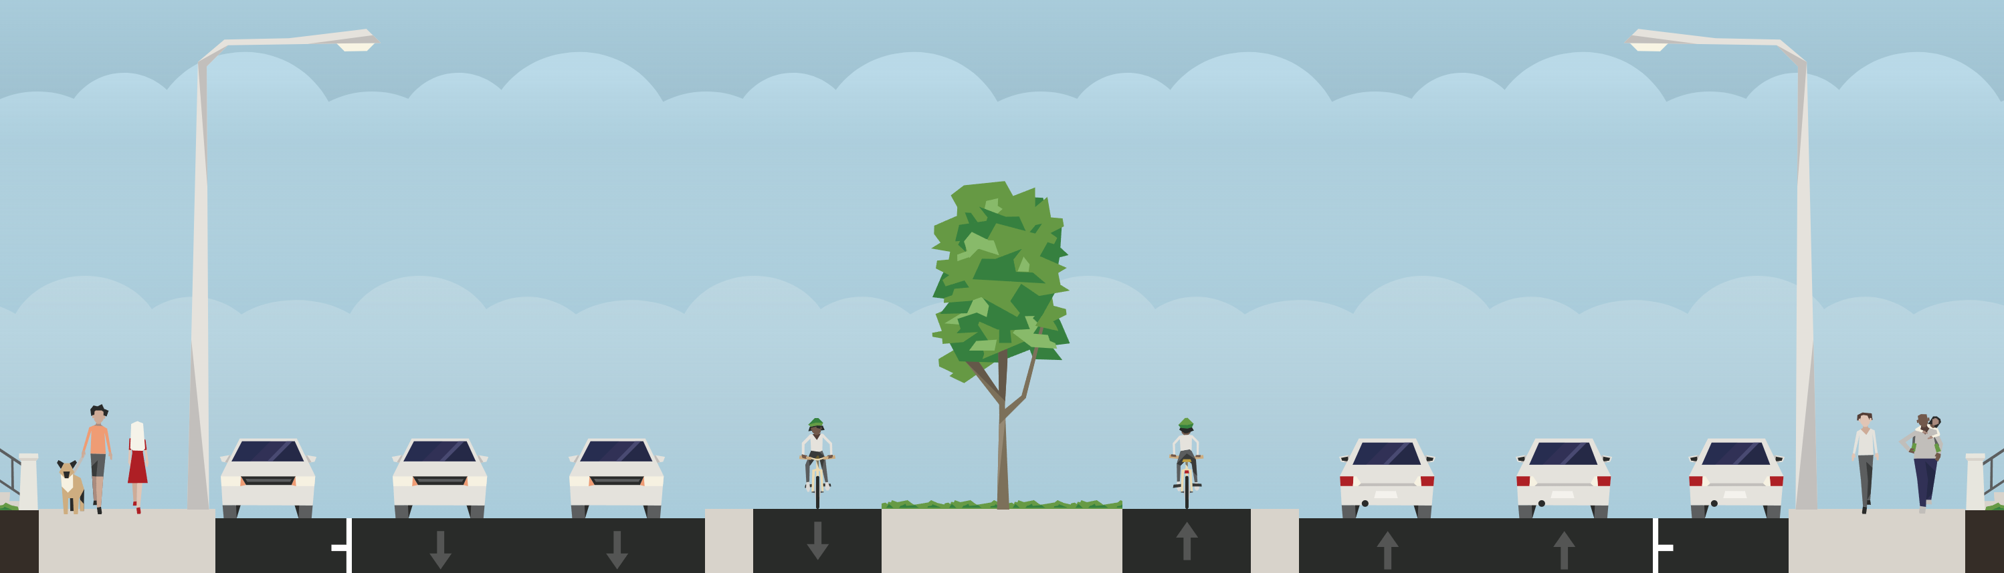
Selected Design: Median Path
  Image: Cross section of the Median Path design option.
8 ft
11 ft
11 ft
40 ft
11 ft
11 ft
8 ft
Parking
Travel Lanes
Median with Path
Travel Lanes
Parking

Slide 10
Next Steps
What are you concerns about this project or the median path design?
Is there anything you would change?
OakDOT will apply for grant funding in June 2024. Would MCPD be willing to provide a Letter of Support?
Read more online or sign up for email updates: https://bit.ly/73rdActive
  Image: Rendering of the
  Median Path design option.

Slide 11
73rd Avenue
Active Routes to Transit
Read more online or
sign up for email updates:
https://bit.ly/73rdActive
Manuel Corona
Jane Mei
ppd@oaklandca.gov
Planning & Project Development
OakDOT

