Slide 1
GSI
(Green Stormwater Infrastructure)
the Why, What, Where, How
Mike Perlmutter
Watershed Program Specialist
Watershed and Stormwater Management Division
Oakland Public Works

Slide 2
Today’s Learning Goals
High-level overview of GSI – what it is, why it’s used, and how it works
Know your responsibilities under our stormwater permit (MRP)
Overview of informational resources on Oakland’s GSI webpage
?Do I need GSI for my project?
Reporting resources and tips for an enjoyable summer
Future Learning Goals
Maintenance overview and practicum
Additional program developments, regulation updates, etc. as needed

Slide 3
Outline
Why GSI (Green Stormwater Infrastructure)?
How Bioretention Works
Monitoring
Maintenance
Reporting
Notes:
The training will provide a high-level overview of GSI – what it is, why it’s used, and how it works.
Staff responsibilities under our stormwater permit (MRP) will be described.
Informational resources will be shared and explained (see this GSI webpage), for example
Do I need GSI for my project?
Technical specs, CAD files, instructions for consultants
Reporting resources and tips for an enjoyable summer

Slide 4
Gratitude
for slide content to
Alina Constantinescu, P.E., Larry Walker Associates
Peter Schultze-Allen, EOA
Emily Meyers, Kelly Havens, Lisa Austin, Geosyntech
Jim Scanlin, City of Newark
Alameda Countywide Clean Water Program
for past training from
Terri Fashing – Watershed and Stormwater Division Manager
Alameda Countywide Clean Water Program colleagues
collaborating colleagues from
Planning and Building
Parks and Tree Services
Project Delivery
Watershed and Stormwater Management

Slide 5
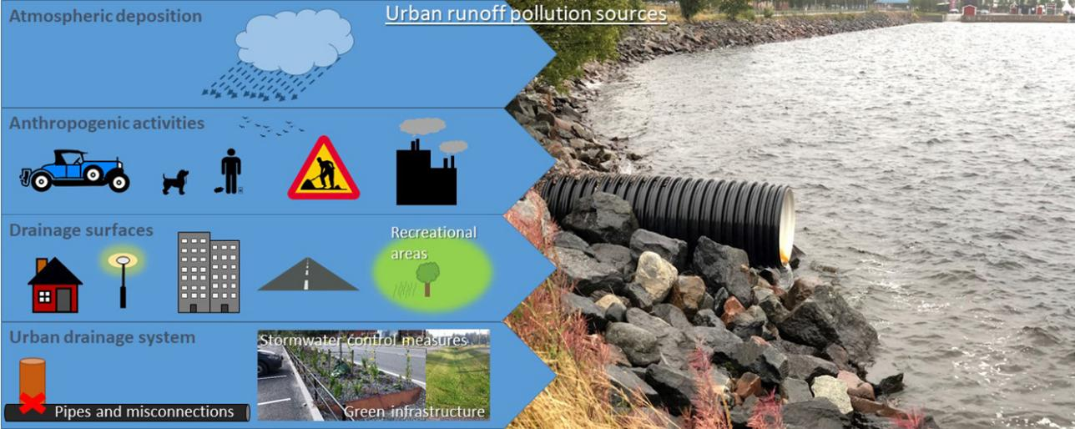
Why GSI?
Buffer against urbanization’s impacts
Urbanization contributes to pollution in waterways
Pollution to Pipeline Problem
Notes:
Urbanization and conversion of natural areas with permeable surfaces and plant canopy to impervious cityscapes has two big impacts on our water systesm
More pollution sources in the environment – and this pollution readily flows from hard surfaces to storm drains that connect to creeks, lakes, bay and eventually ocean
Hardened landscapes direct water downstream, rather than down into the ground – into a pulse of flow through the storm drain system. Cities are designed to drain quickly to prevent flooding and standing water. With no where to percolate into, stormwater shoots through the drainage system
Pollution to Pipeline Problem

Slide 6
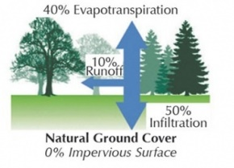
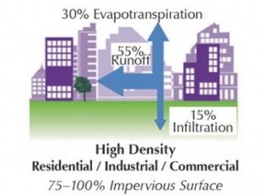
Why GSI?
Buffer against urbanization’s impacts
Urbanization reduces groundwater infiltration and can lead to a
pulse of turbulent, erosive, and pollution carrying runoff to waterways
55%
Runoff
10%
Runoff
15 %
Infiltration
50 %
Infiltration

Slide 7
Quick pulse of
peak flow
as water rushes
over hardscape
to storm drains.
more erosive
&
more polluting
Slower flows
and water in system longer
due to
more ground infiltration
and tree canopy interception
Water discharge
rural
urban
time
Notes:
https://www.researchgate.net/figure/Typical-hydrograph-for-urban-and-rural-runoff-This-hydrograph-shows-the-volume-of_fig1_320472321

Slide 8
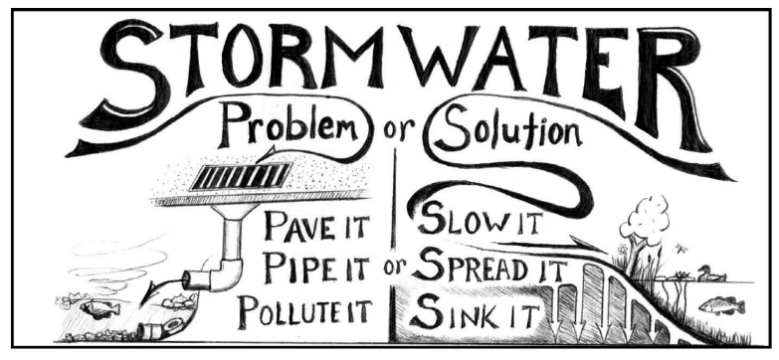
Green Stormwater Infrastructure (GSI) helps compensate for reduced pervious surface area and increased pollution from urbanized areas.
GSI is designed to
Slooooooow, S p r e a d, and Sink
rainwater, remove pollutants, prevent erosion, and sometimes recharge groundwater.
Notes:
https://www.ebmud.com/application/files/2316/1430/1064/Final_Rainwater_Catchment_Presentation_2-25-21.pdf

Slide 9
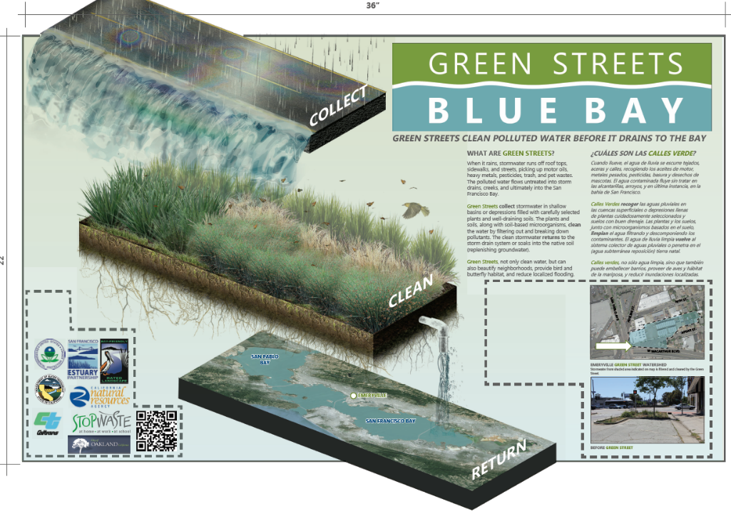

Slide 10
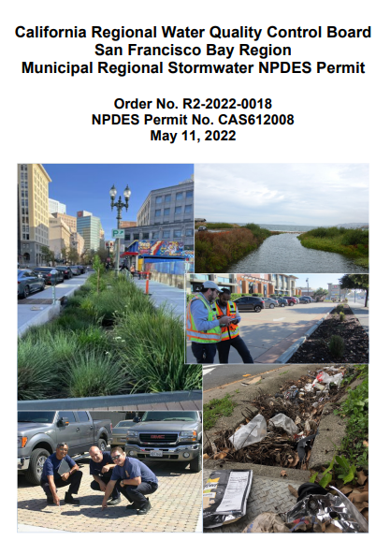
Why GSI? – Required by Law
The California Regional Water Quality Control Board’s Municipal Regional Stormwater Permit (MRP)
requires Oakland and other cities to
treat storm water through GSI.
Permit requires GSI
Installation
Condition monitoring (at least every 5 years)
Maintenance
Reporting
Notes:
https://www.waterboards.ca.gov/sanfranciscobay/water_issues/programs/stormwater/MRP/mrp5-22/R2-2022-0018.pdf

Slide 11
Requirements for Oakland staff
Building Inspectors – PRIVATE PROJECTS (8)
Provide as-built, drainage management area delineation, and O&M plan to Watersheds at project completion
Receive Operations and Maintenance (O&M) agreements for each Regulated site
Receive or solicit annual report from each Regulated site.
Inspect each private “Regulated Project” at least once every five years and at least 15% of projects annually
Enforce needed corrections
Annual report in July of inspection findings
Stay updated on regulations
Participate in Alameda Countywide Clean Water Program committee and trainings
Parks & Tree Services Maintenance – PUBLIC PROJECTS (5)
Implement O&M Plan for City “Regulated Project” from Project Delivery after 3-5-year plant establishment period
Inspect each site at least once/5 years
Maintain and repair as needed
Oversee maintenance contracts such as Oakland Army Base
Annual report in July of inspection findings and program
Drainage Maintenance Division – PUBLIC PRUJECTS (1)
Drainage maintenance of underdrains, cleanouts, etc.
Watershed and Stormwater (2+)
Training, coordination
Annual report to Water Board
Planning (4)
Evaluate proposed projects for stormwater treatment requirements
Annual report in July of regulated and special projects.
Stay updated on regulations
Participate in Alameda Countywide Clean Water Program committee and trainings
Project Delivery - PUBLIC PROJECTS (7)
Evaluate each project for stormwater treatment requirements and feasibility
Annual report in July of “No missed opportunities for stormwater treatment” and project progress
Develop Operations & Maintenance (O&M) Plan for each Regulated Project
  Involve Parks and Tree Services in plan, since they’ll be long-term stewards
Ensure correct installation
Require Plant Establishment contractors to follow O&M Plan and obtain annual contractor inspection reports
At project completion, provide as-built, drainage management area delineation, and O&M plan to Watersheds
Stay updated on regulations

Slide 12


When are annual reports due?
Annual MRP reports to Watershed in July
Watersheds submits report to Water Board by September 30.
We need early submittal to review, revise, etc.
We are reporting for the whole City.
Easy and early collaboration is appreciated!

Slide 13
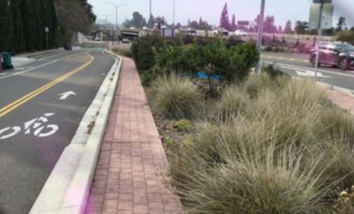
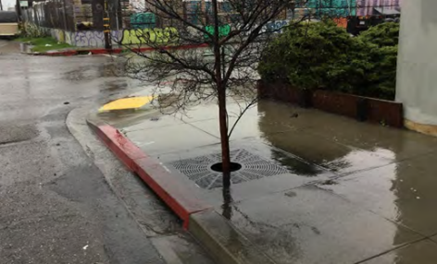
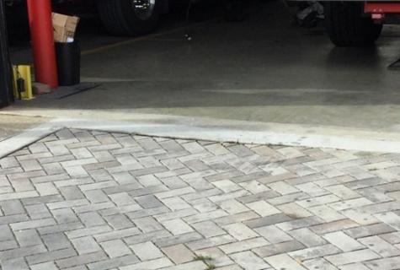
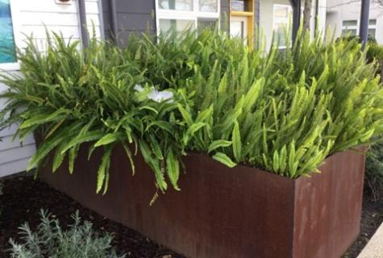
Common GSI Types
What’s most common in Oakland?
Bioretention,
our focus today.
Bioretention
Tree Well Filter
Pervious Pavement
Flow-Through Planters

Slide 14
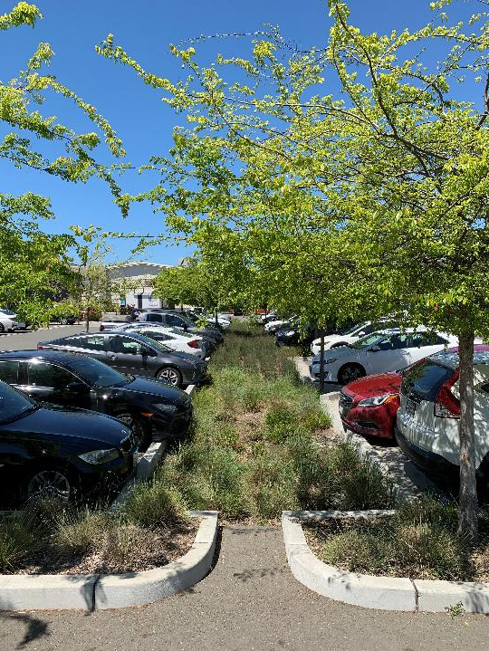
Bioretention Area
a shallow vegetated basin that “treats” runoff by detaining the water and removing pollutants as water passes through layers of mulch, bioretention soil, plant roots, and Class 2 drain rock before infiltrating to the storm drain system and/or groundwater
Notes:
It is generally small-scale - receive stormwater from small contributing areas (e.g. a section of road and roof tops). It serves to slow, store and treat stormwater runoff.

Slide 15
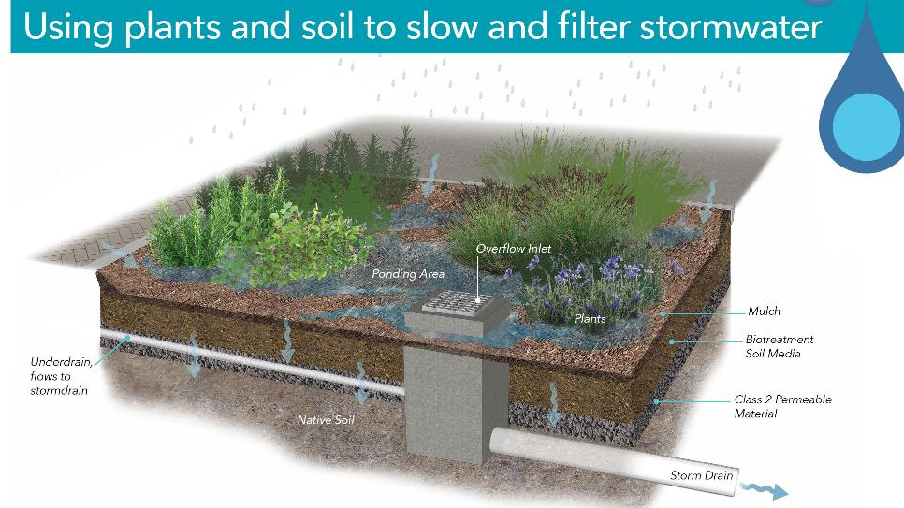
Bioretention – how it works
inflow
Notes:
A bioretention area allows for ponding of stormwater, filtering it through the planted area and through the soil media.
Some of the water is used up by the plants, while some of it infiltrates into the ground where it can replenish the groundwater.
Where site conditions don’t allow for infiltration, a perforated underdrain sends the treated water to the storm drain system.

Slide 16
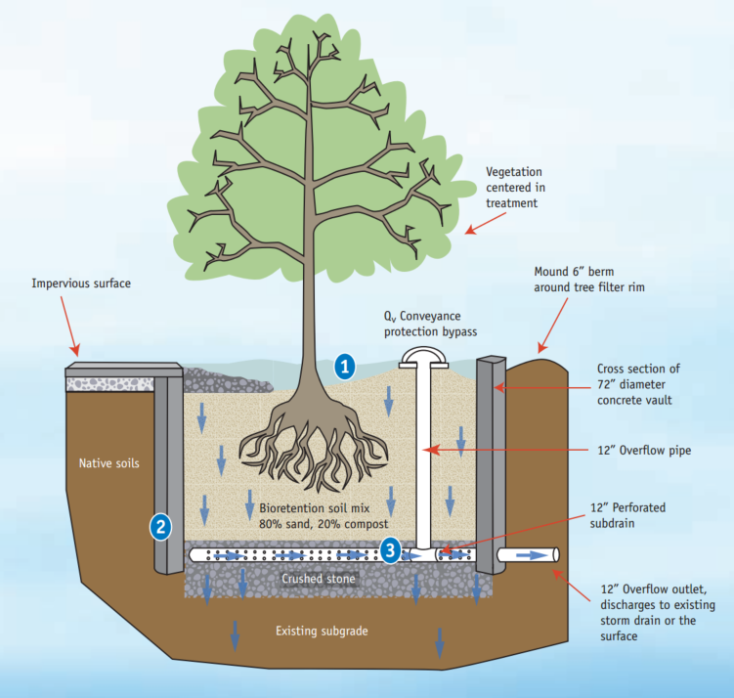
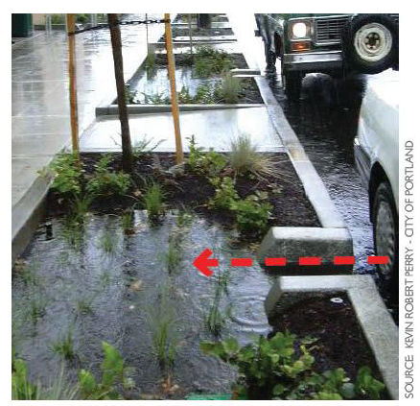
inflow

Slide 17
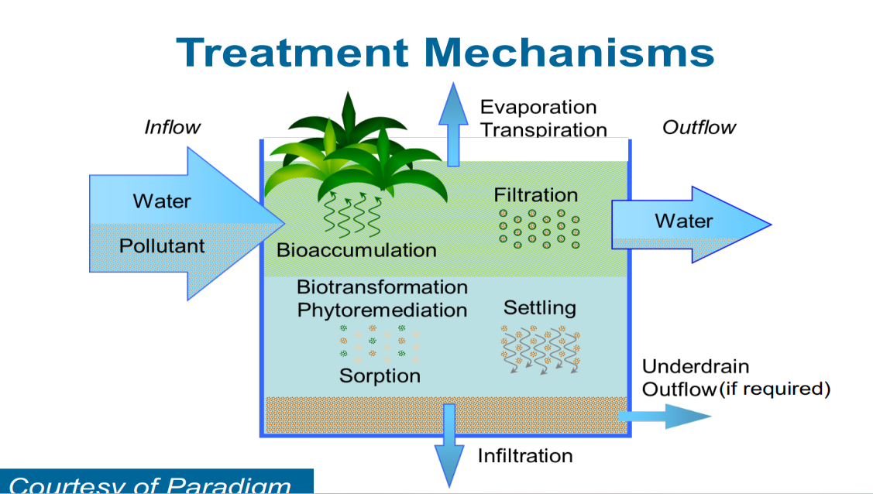

Slide 18
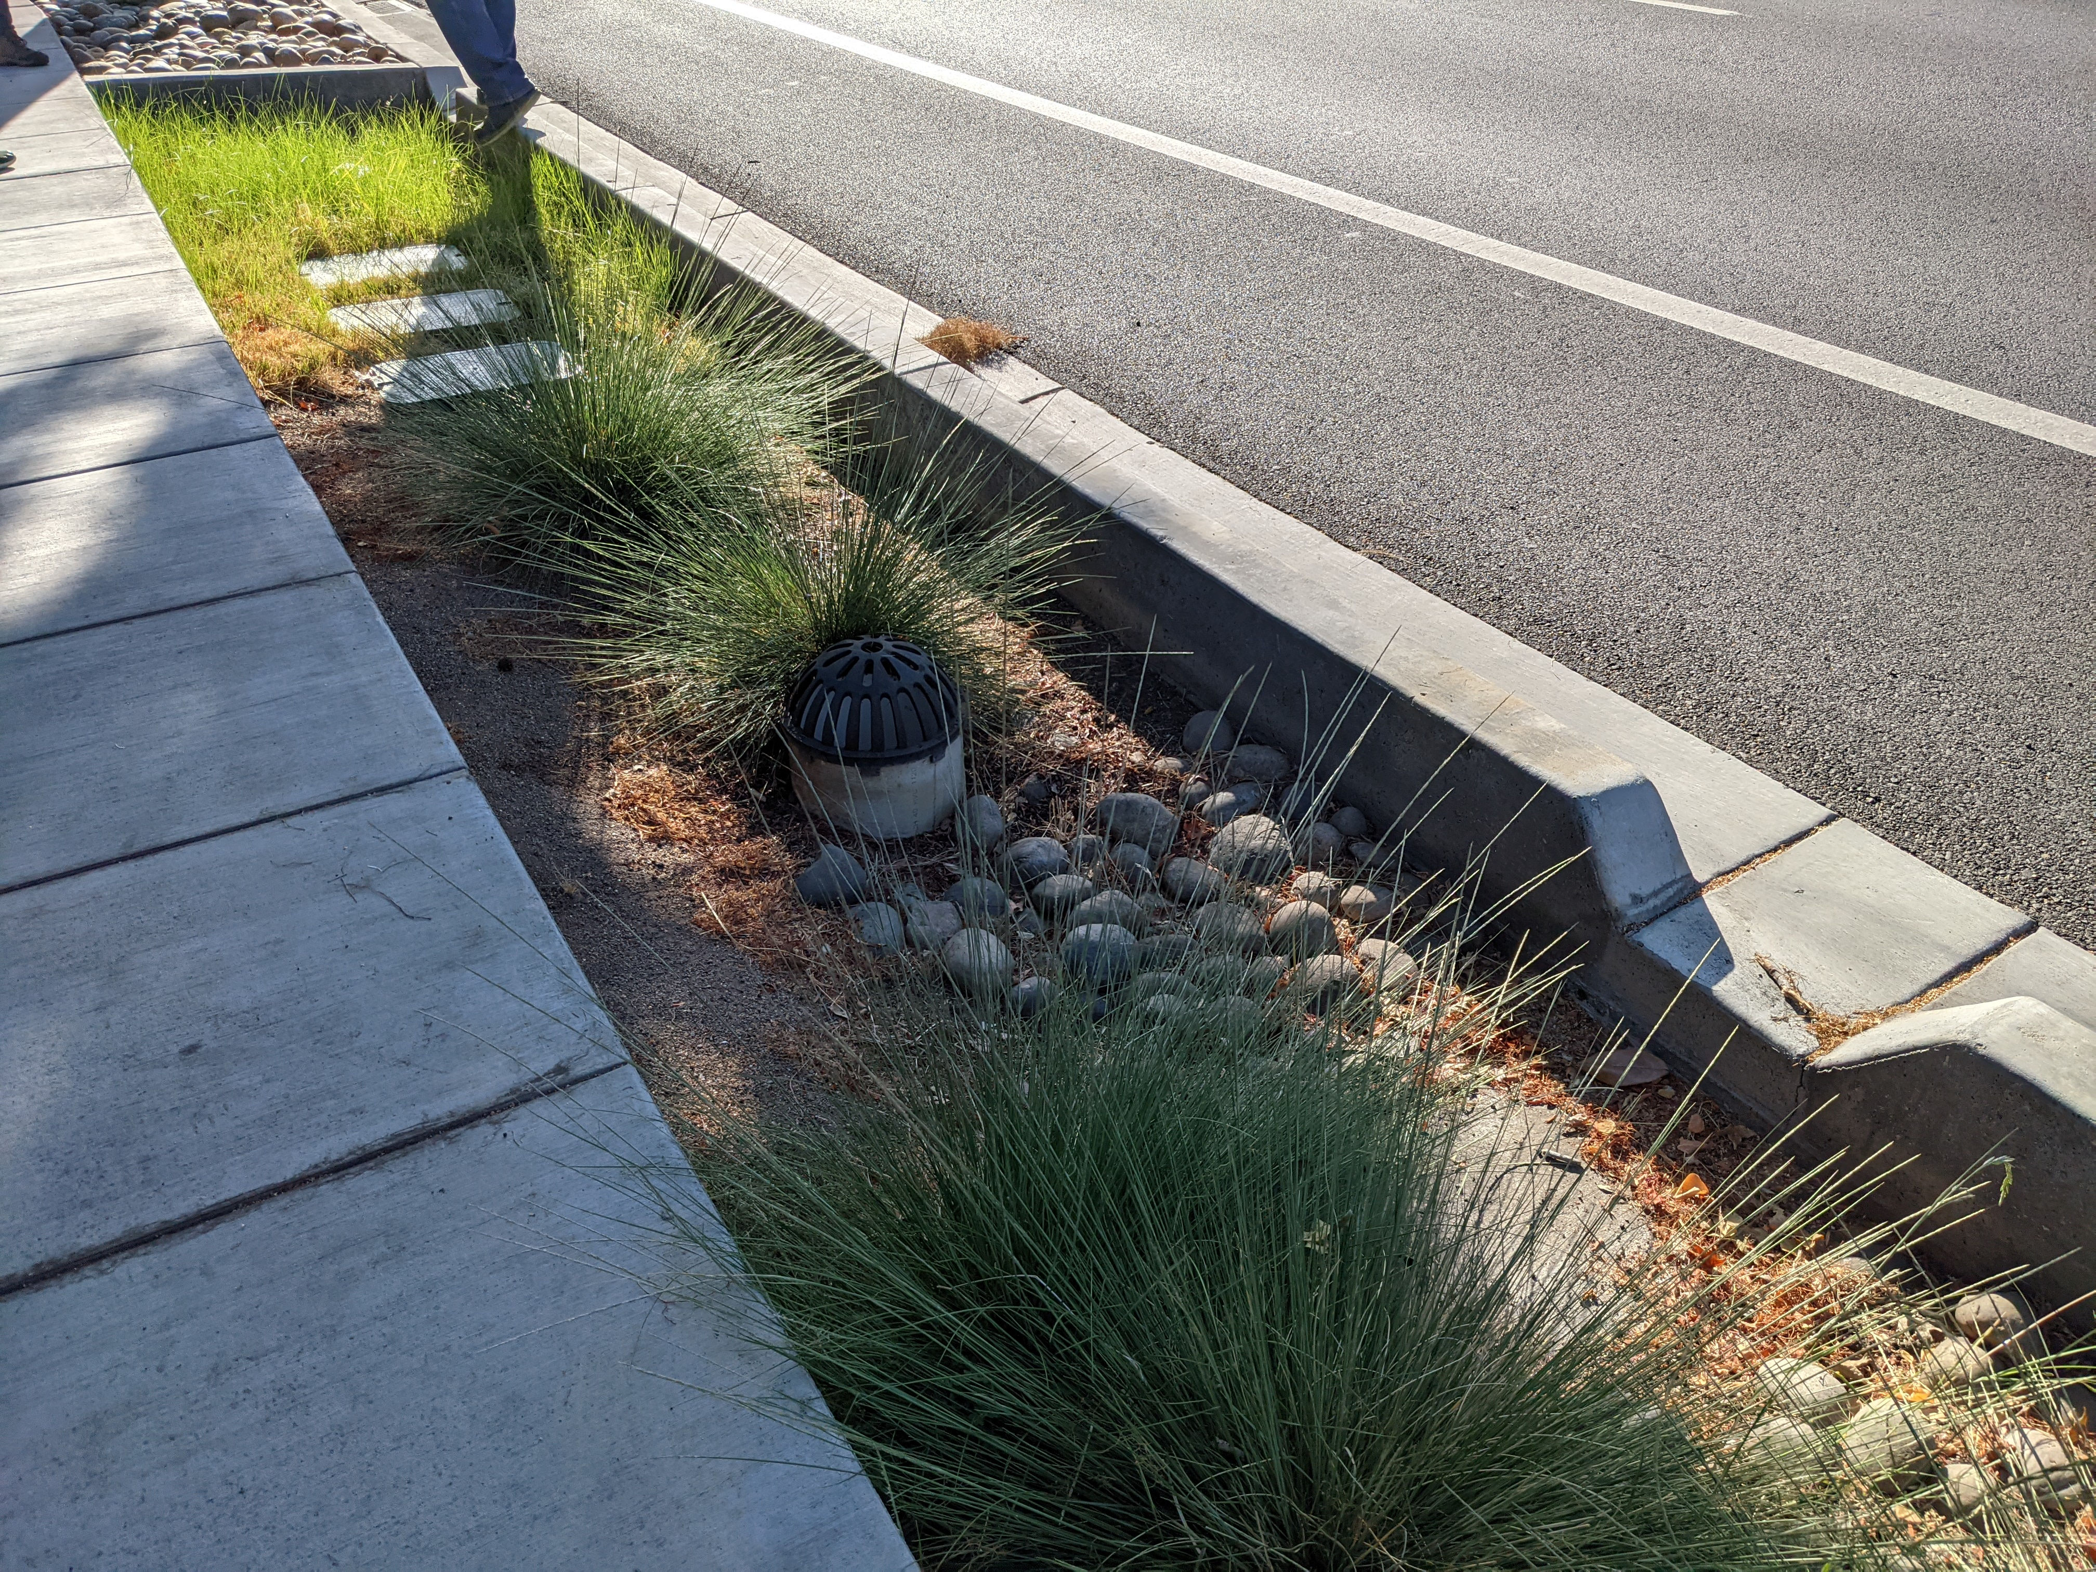
Bioretention
Site Selection
Generally suitable for small-scale drainage area (up to 2 acres)
Must allow for setbacks from
buildings and utilities
Not suitable for areas with steep slopes or other potential
geotechnical hazards
  *Though C.3 “Alternative Compliance” required for Regulated Projects
Notes:
Min 5 ft from seasonal high groundwater level – if there is less than 5ft bw bottom of the facility and gw, or infiltration not allowed due to other constraints, impermeable layer should be placed be drain rock and the bottom and the underdrain placed on top of that liner.
Setback requirements may vary by agency. Structural/geotech engineer may impose restrictions based on site conditions.
Generally min 10’ from buildings.
Liners or sleeve utilities may be used if utilities setbacks cannot be met.

Slide 19
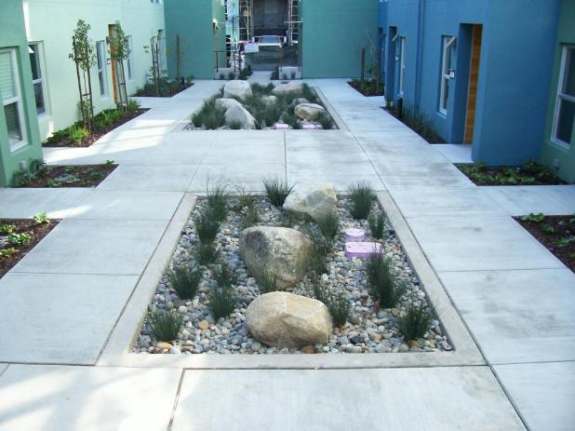
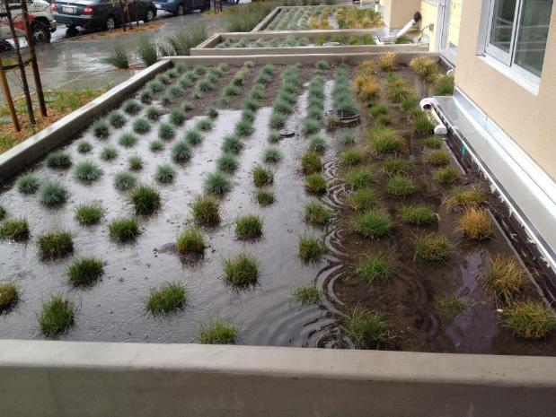
Bioretention Site Selection
What if there’s contaminated soils or high groundwater?
Use concrete bottomed lined systems
In ground lined flow through planter
Flow-through planter treats roof runoff

Slide 20
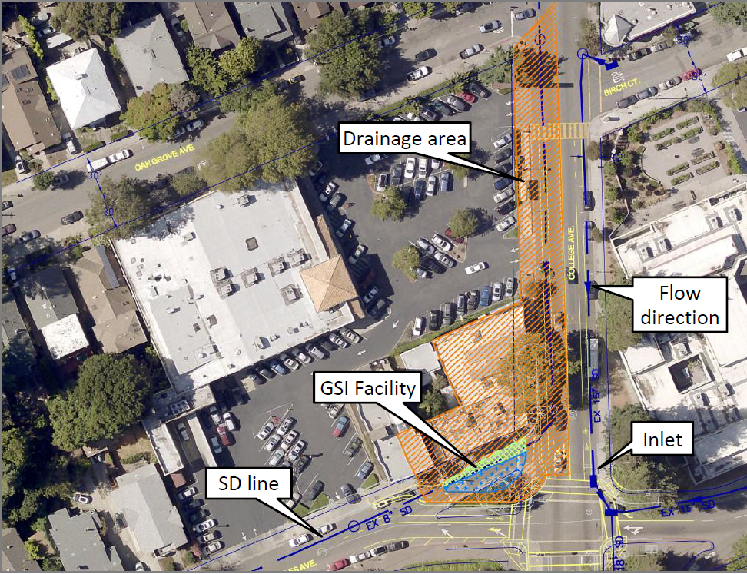
Example GSI Drainage Area
We’d love for these to be submitted from
GIS or CAD.
Notes:
Better drainage management area graphics showing how this works with contours and flow, and what would be ideal for porting into AGOL?

Slide 21
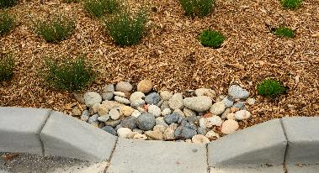
Bioretention Areas System function and components - INLET
Energy dissipater such as cobble
Curb opening (18” min) or overland flow
Notes:
Runoff may enter bioretention area as sheet flow, but curb cuts are far more common.
Overflow structure in picture looks too low
Install overflow structure far from inlet so as not to short-circuit the system

Slide 22
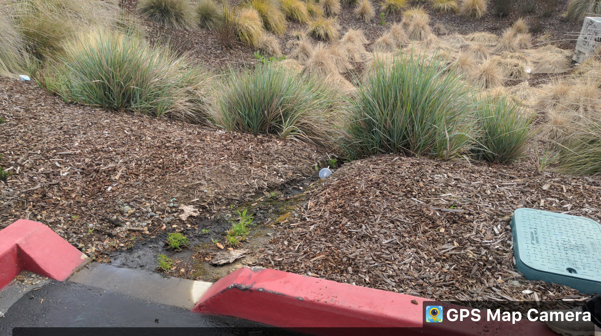
Bioretention Areas System function and components - Cobble
What’s missing?
OOPS – EROSION AT MISSING COBBLE
Notes:
Runoff may enter bioretention area as sheet flow, but curb cuts are far more common.
Overflow structure in picture looks too low
Install overflow structure far from inlet so as not to short-circuit the system

Slide 23
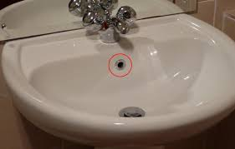
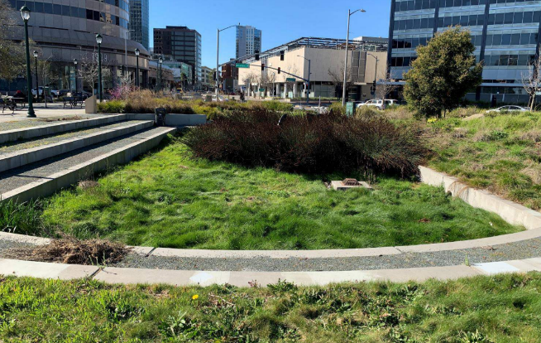
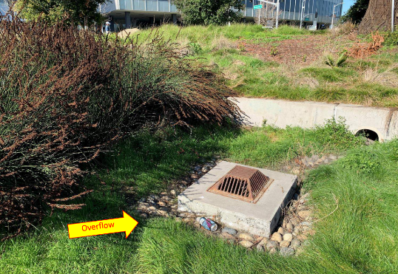
Bioretention Areas
System function and components
Overflow structure
  Conveys flows above the facility’s capacity
  directly to the storm drain
  Works like the overflow in a bathroom sink
  Min 6” higher than the lowest point in the facility*
  Install far from inlet
*elevation constraints may preclude 6” overflow
Snow Park, Oakland

Slide 24
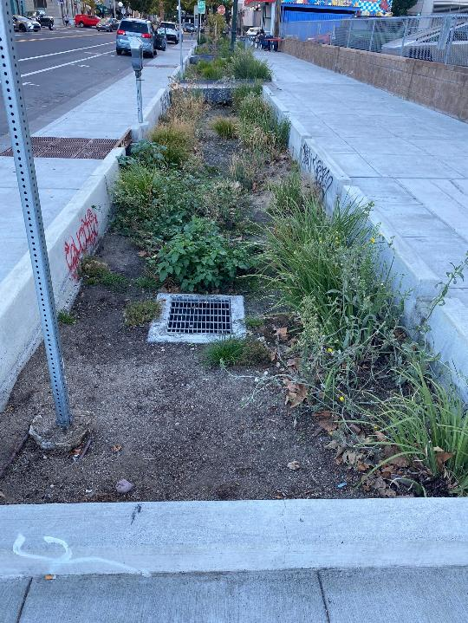
San Pablo and 16th St in front of HOTBOYS
Overflow drain for various engineering reasons, could not be 6” above surface.
Facility oversized compared to the drainage area.
Instead of ponding, the system has enough surface area and soil infiltration capacity (> 5 inches/hour) to accommodate the design storm (.2 inches per hour).
Overflow
at surface grade
surface grade is eroded

Slide 25
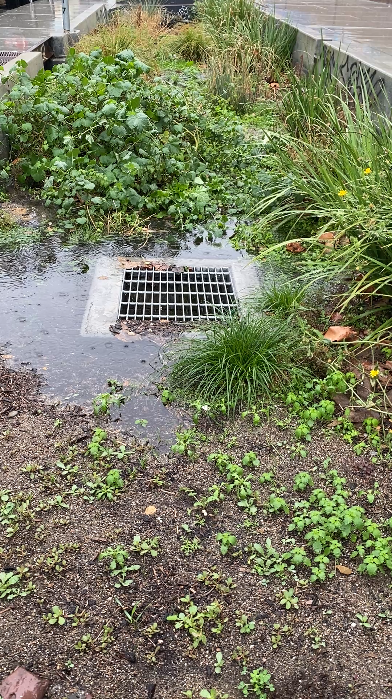
November 13, 2025 heavy rainstorm
San Pablo and 16th St in front of HOTBOYS
Water flowing over the top of the surface directly into the overflow and bypassing the system and pollution removal treatment.
Mulch is being washed into the overflow.
Lack of stormwater treatment may be a design shortcoming, or related to maintenance needed for the soil levels and grading, or a combination.

Slide 26
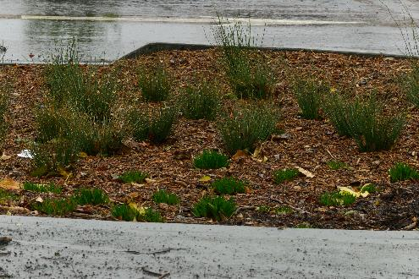

Bioretention Areas System function and components
Mulch
  Suppresses weeds, retains soil moisture, and replenishes soil nutrients
  3-inch layer on exposed areas between plants
  ‘Arbor’, ‘aged’ or ‘composted’
  mulch or pea gravel, rock cobble
  recommended
  Bark, ‘gorilla hair’, and dyed mulches
  NOT recommended
Notes:
Mulch reduces the ability of weeds to establish, keeps soil moist, and replenishes soil nutrients

Slide 27
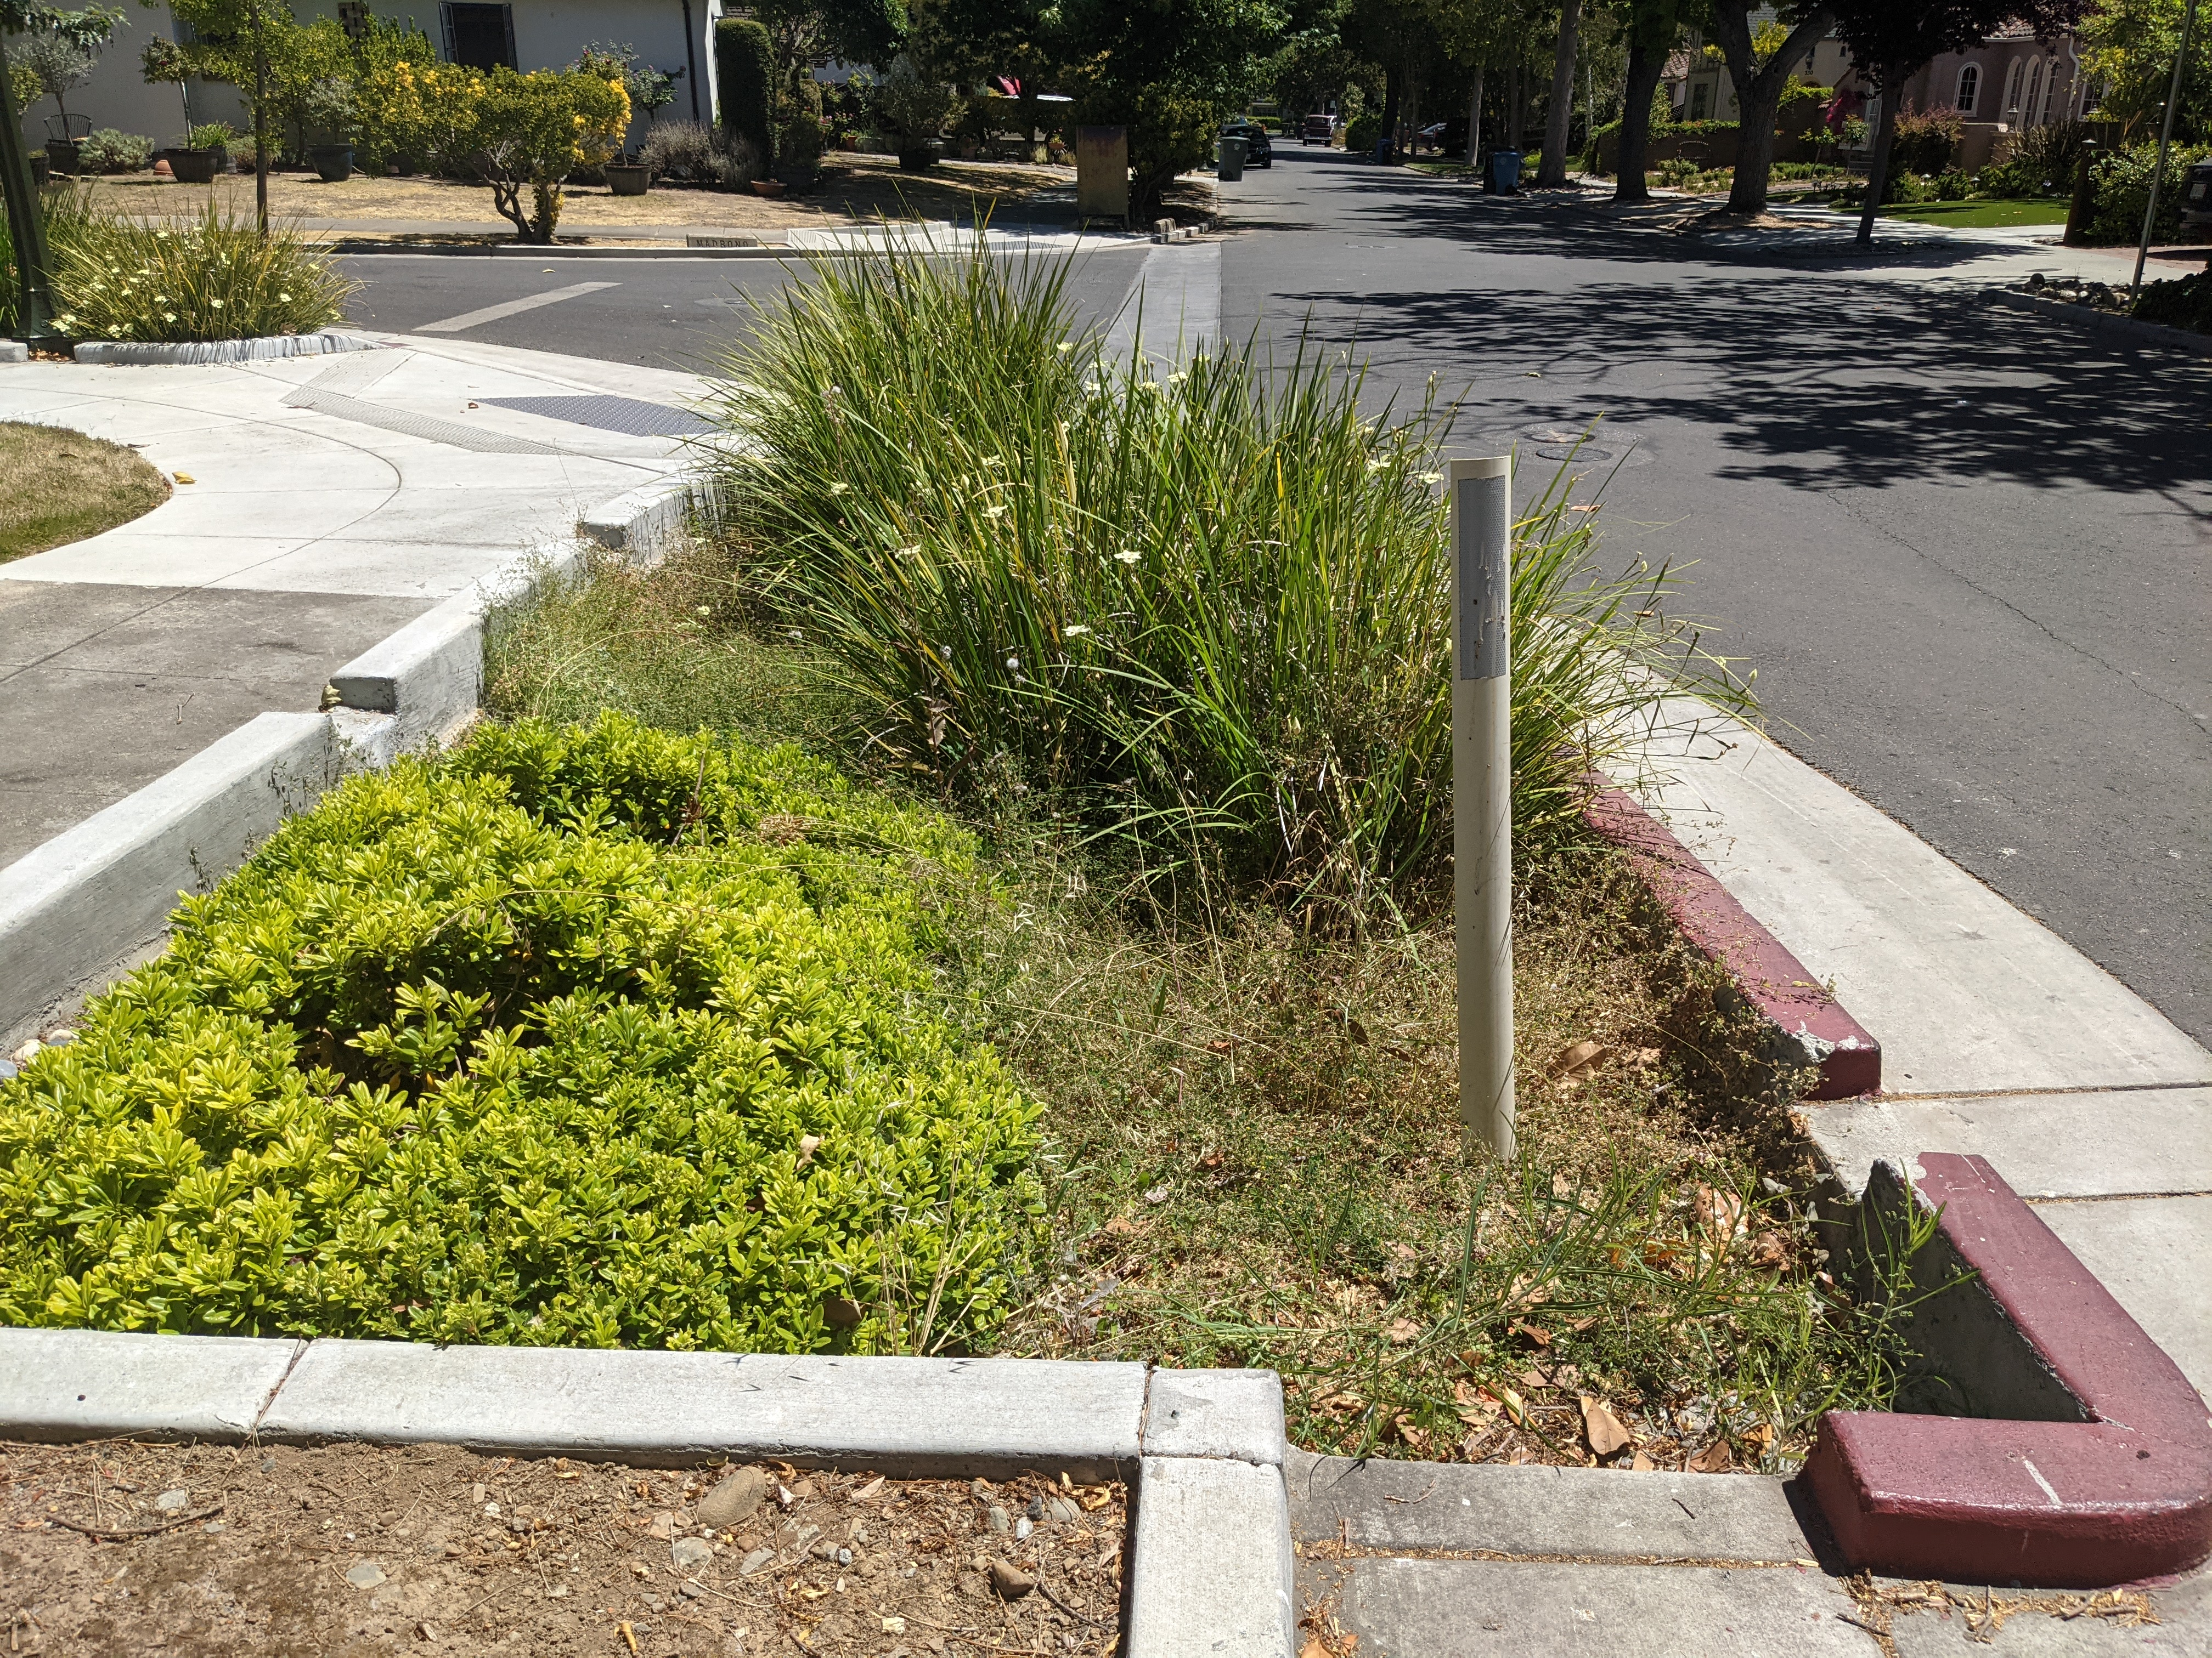
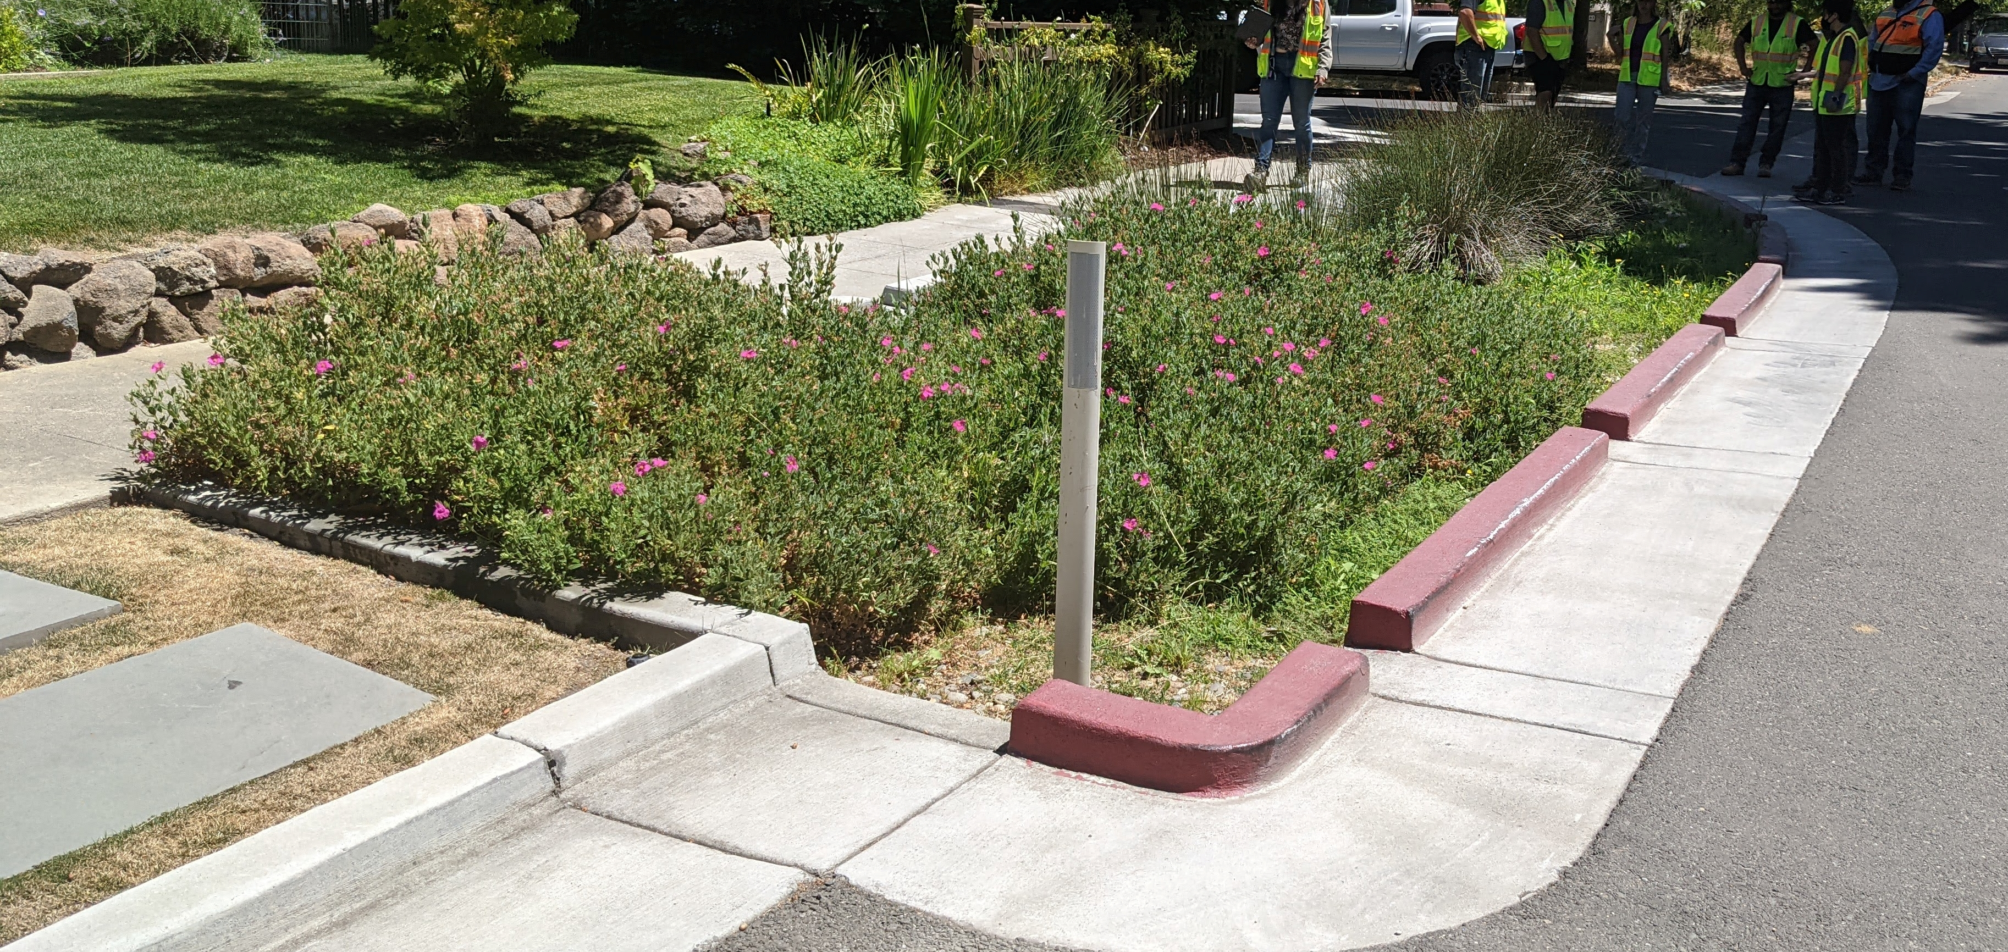
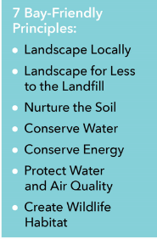


Bioretention Areas
System function and components
Plants
  Suitable to well-drained soils and occasional inundation
  (see list in Appendix B of C.3 Manual)
  May need irrigation, especially during establishment period
  Drought-tolerant plants preferred
  Use Bay-Friendly Landscaping principles
  Calscape native plant database

Slide 28
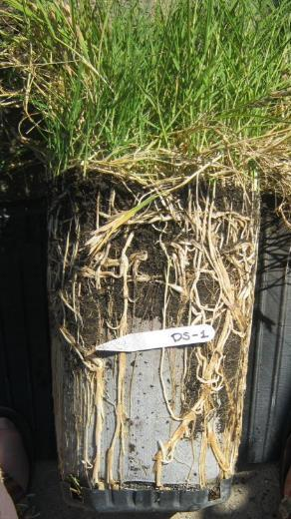
Role of Plants
Plant roots penetrate soil creating flow paths
Nutrient, metal uptake & volatilization
Wildlife habitat & food
Feed soil organisms
Soil restoration
Evapotranspiration
Slide credit: Megan Stromberg, WRA, Inc.

Slide 29
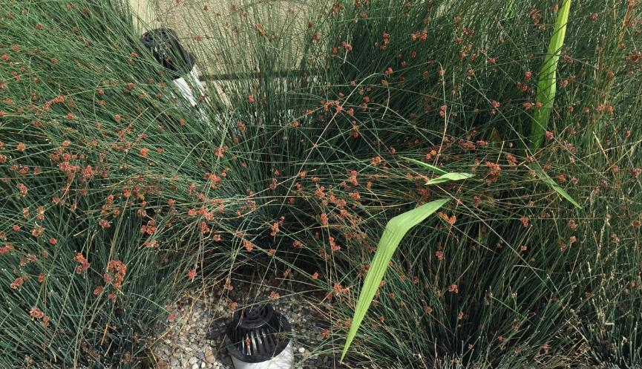
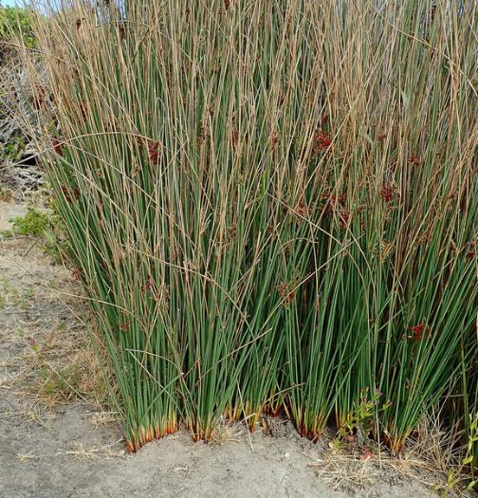
Juncus patens
California grey rush, spreading rush, common rush

Slide 30
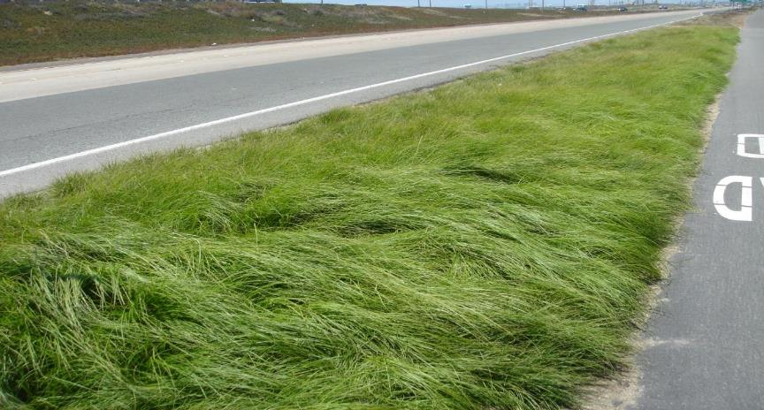
Carex pansa
Meadow or sand dune sedge

Slide 31
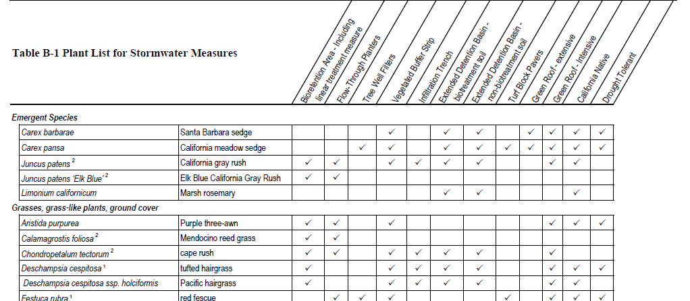
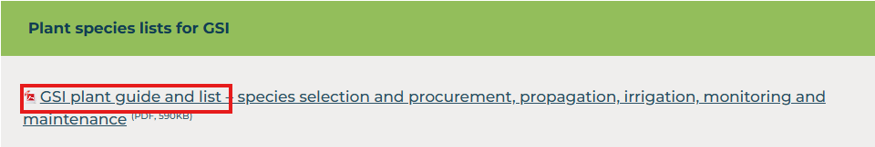
Plant selection guidance document from Alameda Countywide Clean Water Program
Oaklandca.gov search GSI or Green Stormwater

Slide 32
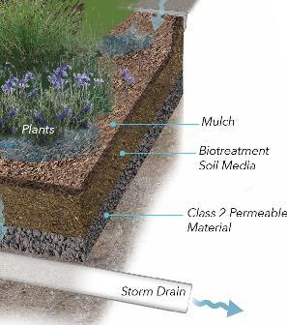

Bioretention Areas System function and components
Biotreatment soil media (BSM)
  18” minimum depth
  Sabulous: 60%-70% sand and 30%-40% compost
  Minimum of 5” per hour infiltration rate
  Specifications must be verified through testing or certified from provider. See Appendix K of C.3 Manual for all BSM requirements
    See www.cleanwaterprogram.org for detailed specification, list of BSM providers, provider certification, and verification checklist
On OaklandCA.gov search GSI, or Green Stormwater
Notes:
The BSM ensures good long-term infiltration and moisture retention to support healthy plants.
See Regional Board requirements and Appendix K of the Alameda County C.3 Manual.

Slide 33
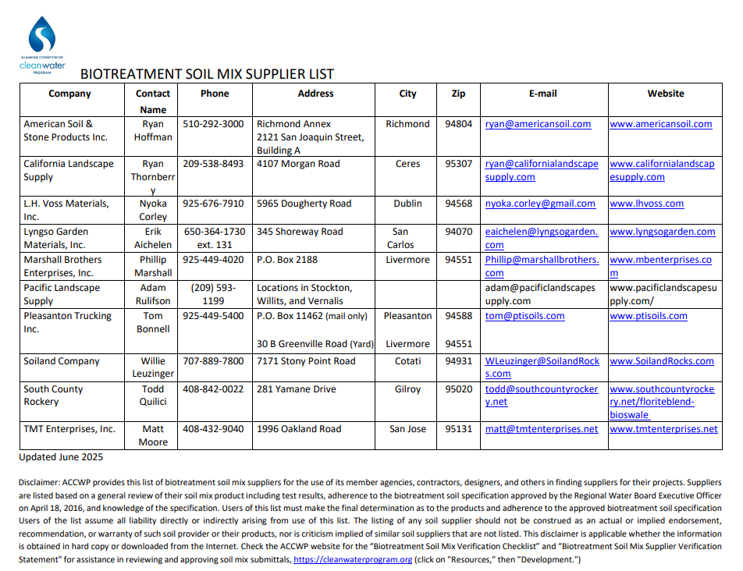
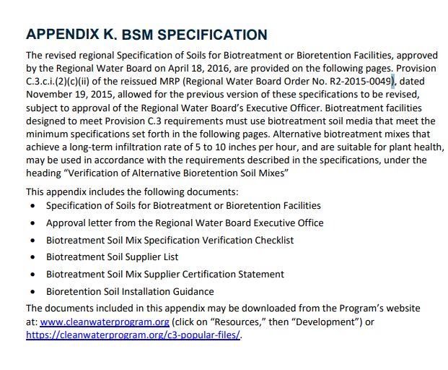

Slide 34
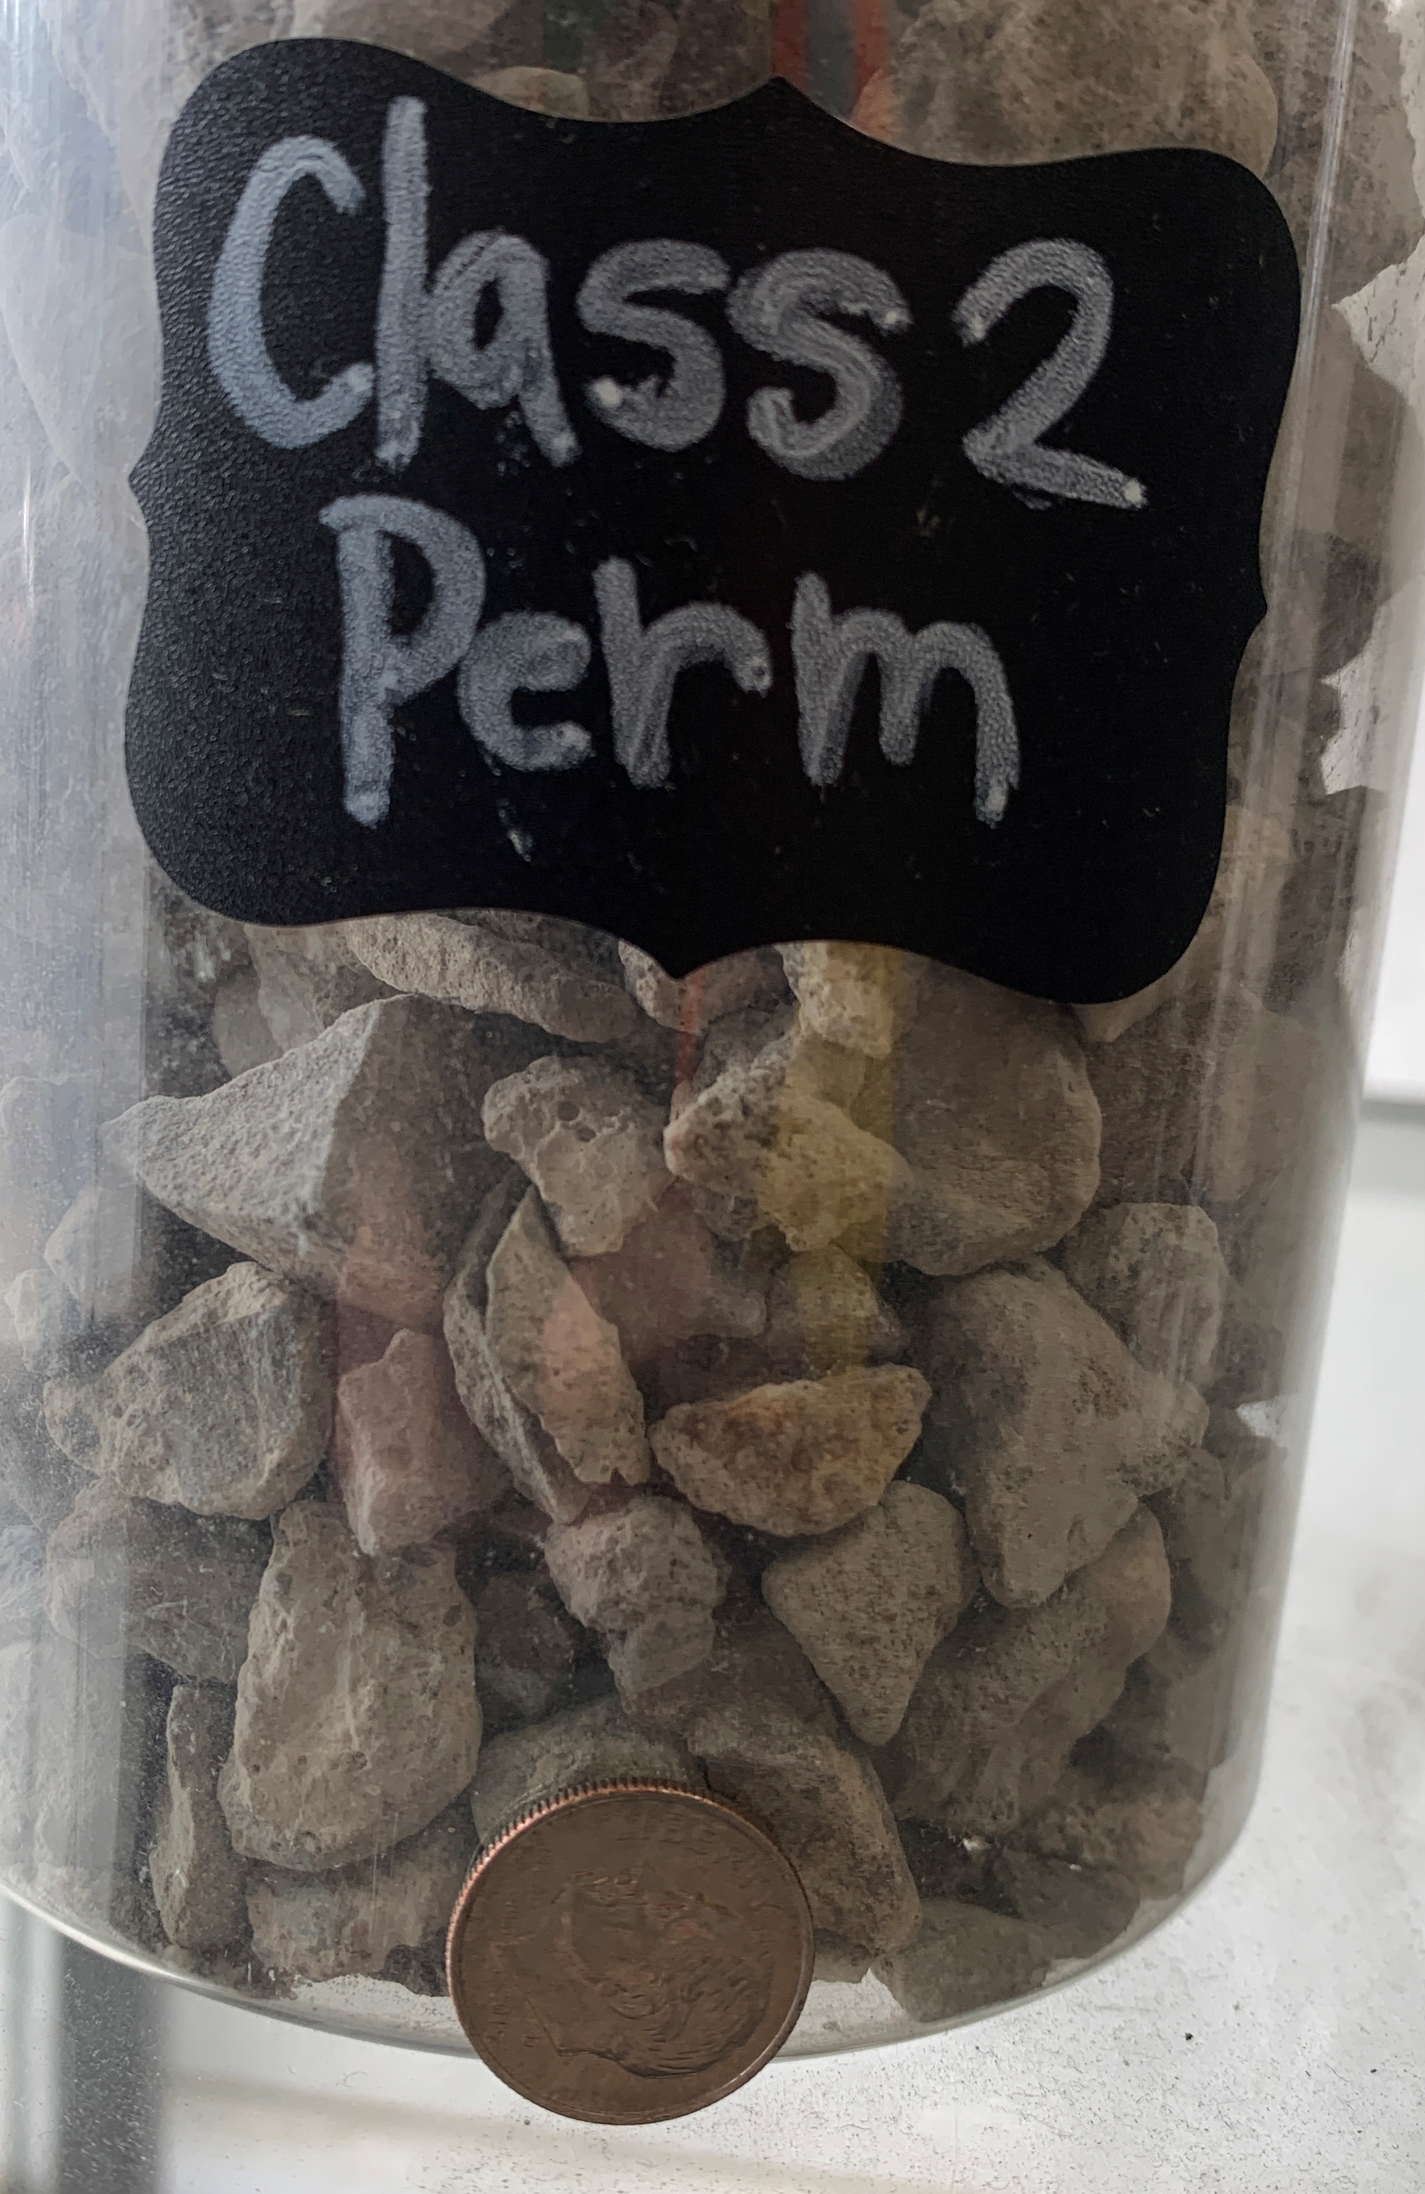
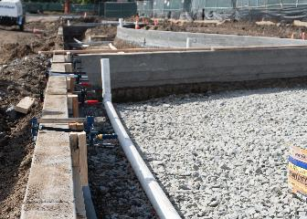
Bioretention Areas System function and components
Class 2 Permeable Material
rock per Caltrans specifications
  12” minimum depth
Perforated underdrain
  Low permeability soils or
  other infiltration constraints
  Min 4-inch diameter pipe,
  with downward perforations
  Placed on top of gravel layer
Notes:
Underdrain – may be required by local agencies even at sites with good soil drainage. Recommended for sites with poor native soils (saturated hydraulic conductivity < 1.6 in/hr)
Should have cleanouts
A bioretention area that is unlined and has a raised underdrain in the underlying rock layer to promote infiltration may also be called a “bioinfiltration area”.

Slide 35
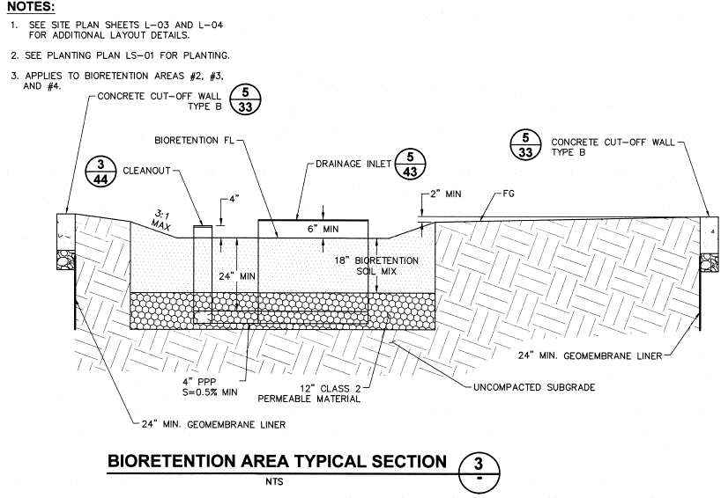

Component | Requirement
Side slope | 3:1 Max
Curb cuts, if used | Min 18” wide, followed by energy dissipater
Overflow inlet height | Min 6” above low point of planting media
BSM layer | Min 18” deep
Aggregate layer | Min 12” deep, Class 2 permeable material, graded rock
Perforated underdrain | 4-in diameter, 0.5% min slope, downward perforations, with cleanout
ponding
overflow
Notes:
Point out all the elements previously discussed:
3.1 slopes
18” min BSM
12” min Class 2 permeable material
6” min height of inlet
Perforated drain with 0.5% min slope
UNCOMPACTED subgrade

Slide 36
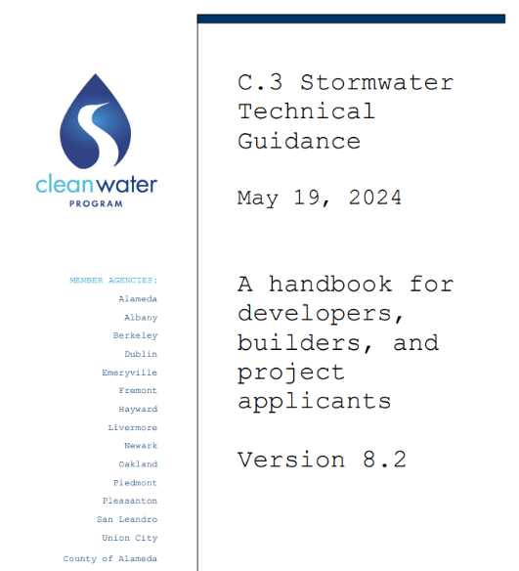
Check the specs!
In the Alameda Countywide C.3 Technical Manual
On OaklandCA.gov search GSI, or Green Stormwater
Notes:
https://cleanwaterprogram.org/wp-content/uploads/2024/05/C3TG-8.2-compiled-20240519.pdf

Slide 37

Getting Bioretention done right
(and learning from past mistakes)
Calibrating quiz for construction requirements
(Some things to inspect for)

Slide 38
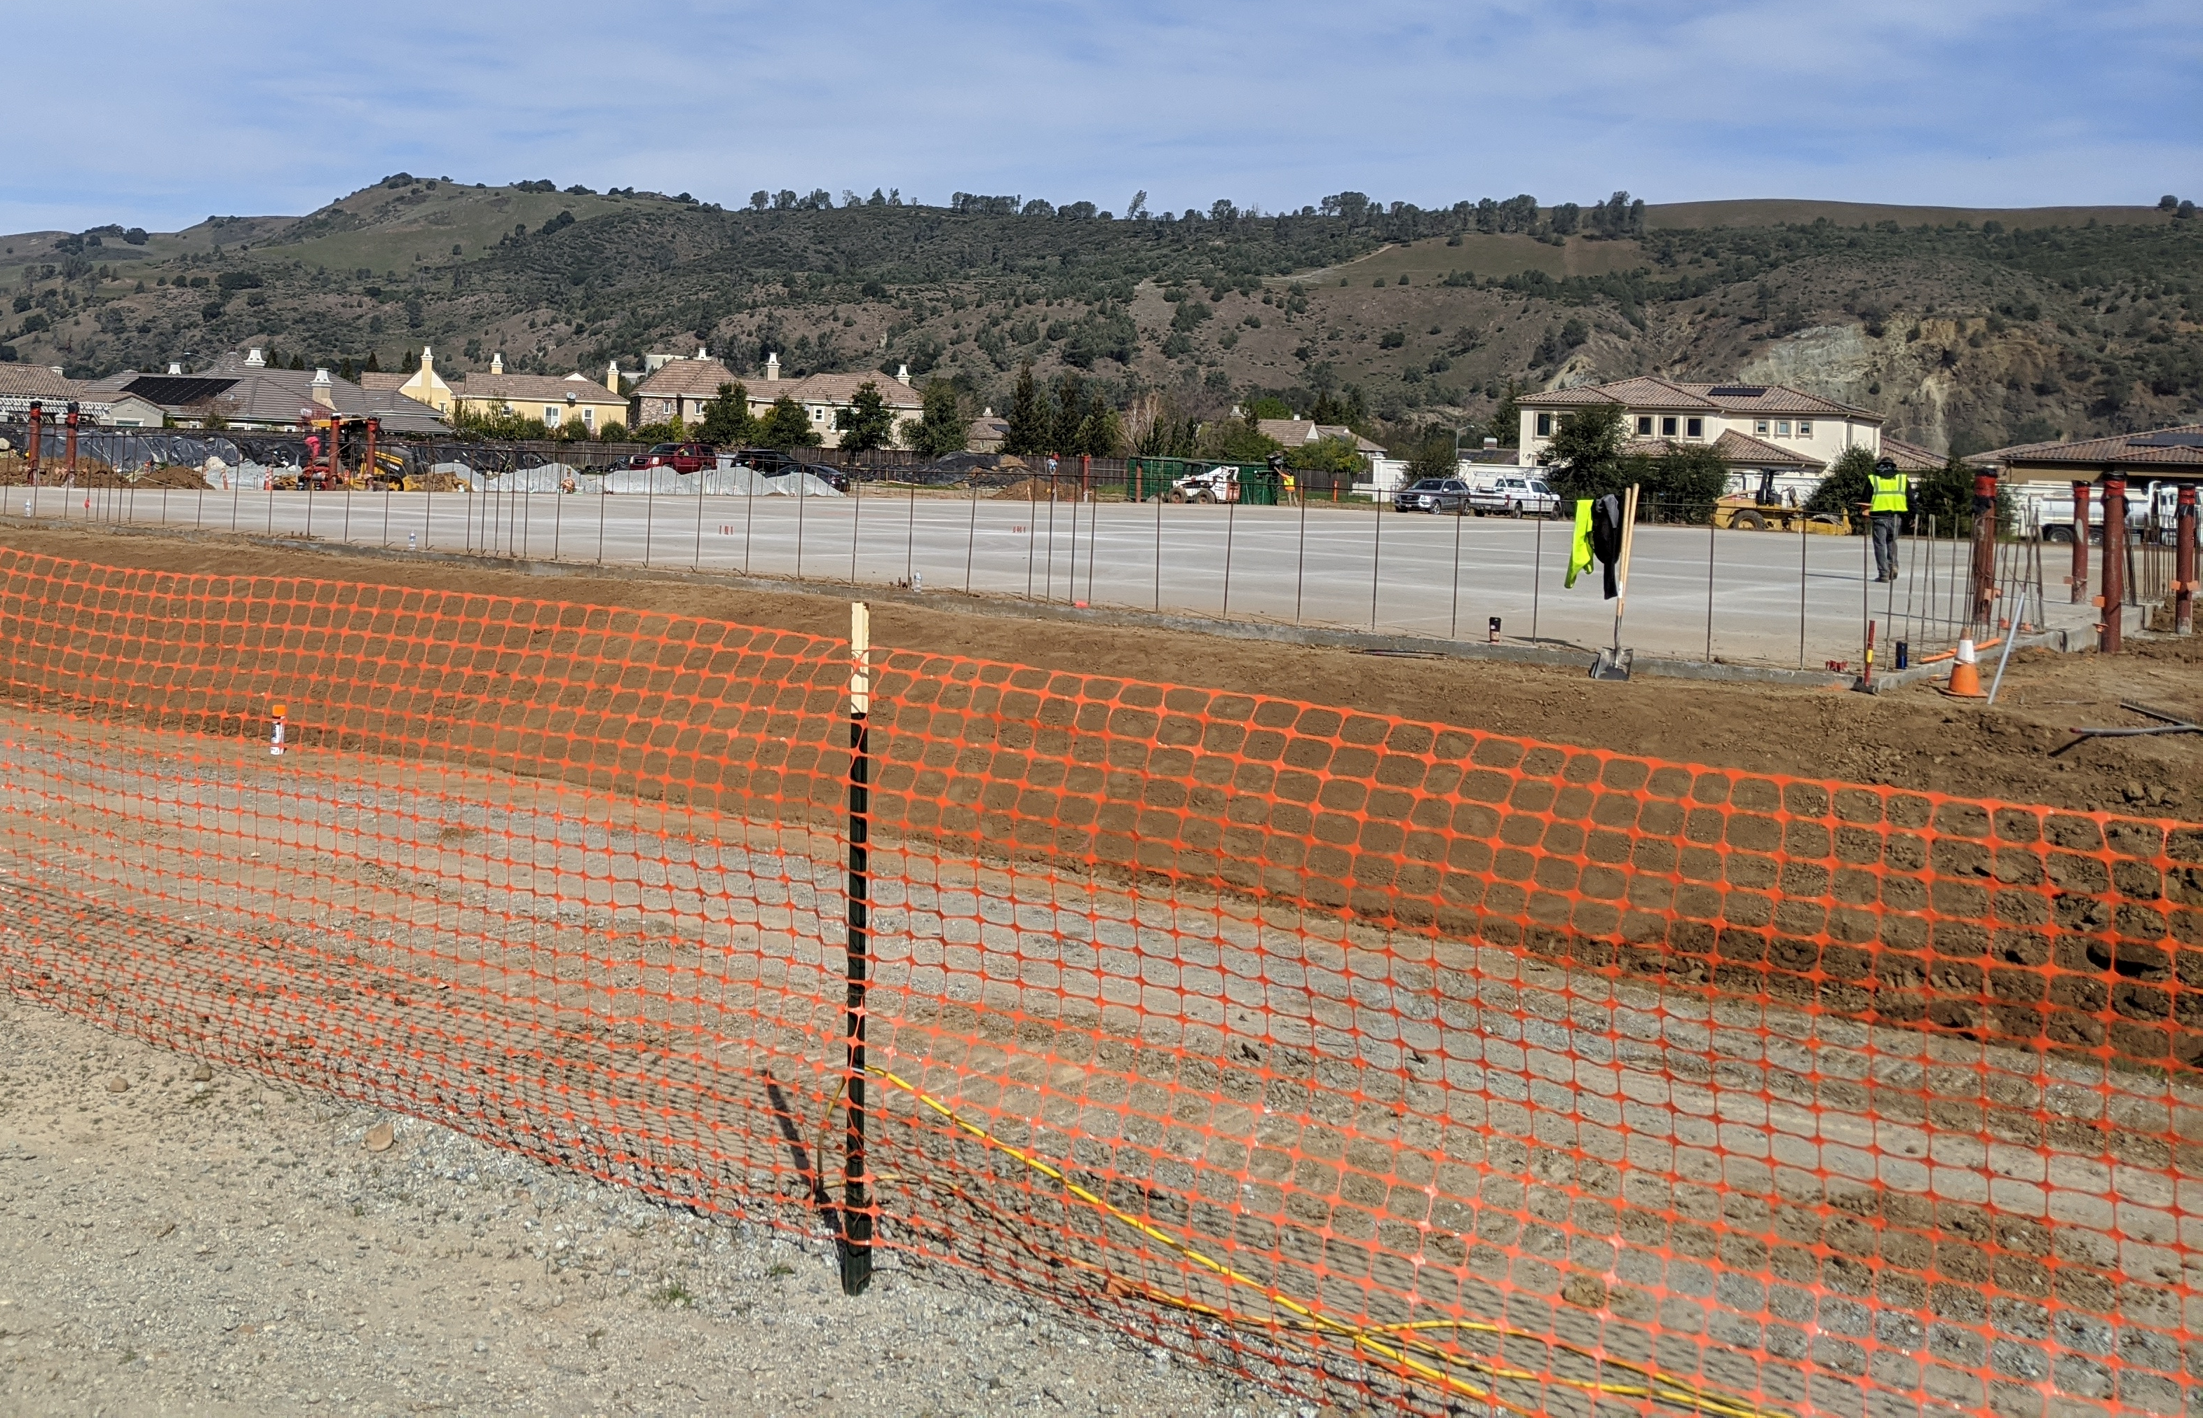
Bioretention Construction Phase –
Protection
Minimize compaction of soils and materials.
Keep heavy equipment off facility footprint at all times.
Protect area from construction site runoff to avoid silt and fines deposition in the facility.
Protect integrity of construction materials prior to installation. Example: prevent BSM pile from washing into downstream stone pile.
Block off inlets until system is ready and surrounding construction is completed.
Notes:
High compaction results in low infiltration rate.
Over compaction means compaction of soils/materials to the point where they do not function as intended. One must ALWAYS be concerned with over-compaction of soils and materials.

Slide 39
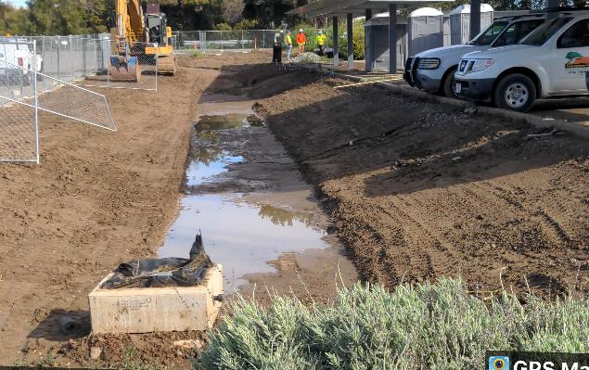
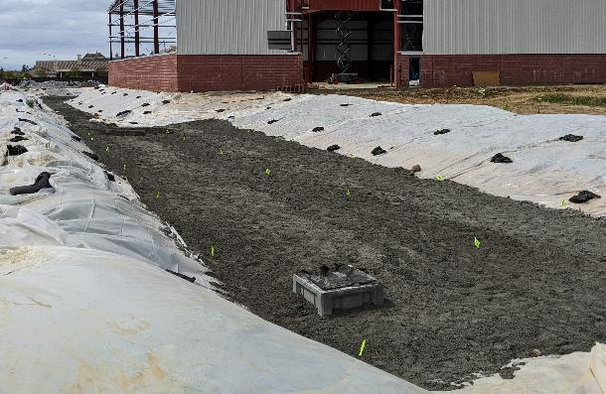
Bioretention Construction Phase - Protection
  What’s wrong with this picture?
  What’s right with this picture?
Unprotected slopes.
Rutted with erosion
The plastic on the slopes protects from erosion until landscaping is installed.
Protects the basin from sedimentation that would compromise infiltration capability.

Slide 40
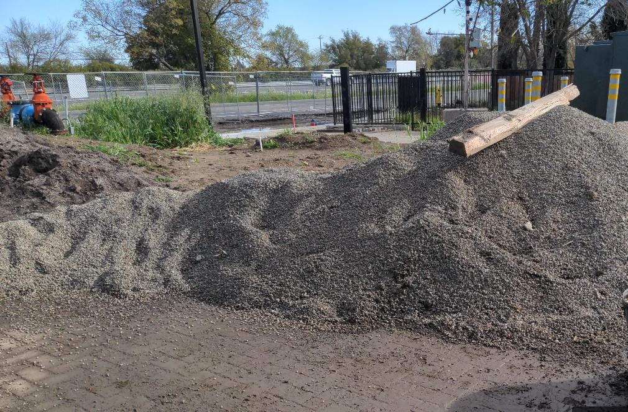
Permeable Pavers construction oops
  What’s wrong with this picture?
  Material pile stored on permeable pavers,
  clogging the spaces
  where
  water would drain.
  Contractor instructed to remove pile and vacuum clean the pavers.

Slide 41
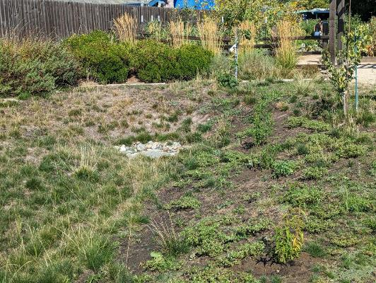
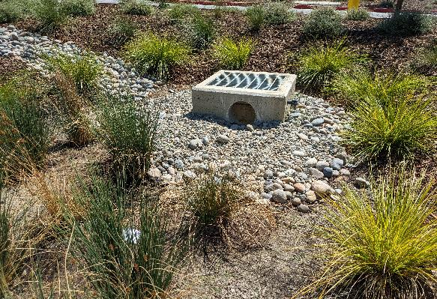
Bioretention Construction Phase – Common Issues
  What’s wrong with this picture?
  Overflow should be ≥ 6” over low spot
  How about this one?
  Good!

Slide 42
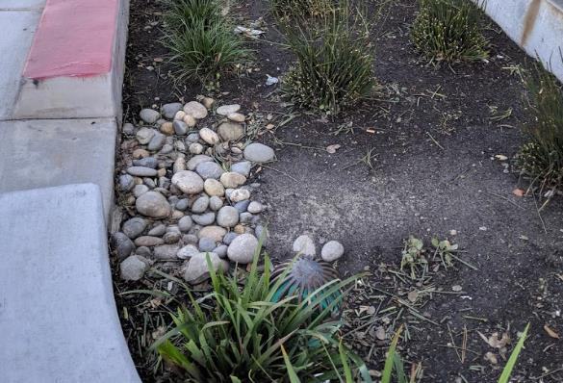
Bioretention Construction Phase – Common Issues
  What’s wrong with this picture?
  Overflow should be far from curb inlet to prevent inflow from bypassing treatment

Slide 43


Bioretention Construction Phase – Common Issues
  What’s wrong with this picture?
  No energy dissipator at inlet - flow channelizes and erodes

Slide 44

Bioretention Construction Phase – Common Issues
  What’s wrong with this picture?
  Inlet blocked by light pole footing, obstructing water flow

Slide 45


Bioretention Construction Phase – Common Issues
  What’s wrong with this picture?
  No irrigation, dead plants

Slide 46

  What’s wrong with this picture?
  ALMOST EVERYTHING!!!
  Bioretention basin filled with trash
  No plants growing

Slide 47

  What’s wrong with this picture?
  IT’S ALL GOOD!
  Structures look good
  Inlets clear
  Energy dissipaters at inlets
  Overflow at right height and place
  Plants look healthy and well maintained

Slide 48
After installation
Reporting
Monitoring
Maintenance

Slide 49
Reporting – Planning Stage
Except where noted, applies to both PUBLIC and PRIVATE
All Projects are considered for stormwater treatment
Is the project “REGULATED?” (≥the threshold of impervious surface and REQUIRES stormwater treatment)?
PUBLIC CITY, and NON-Regulated but treating stormwater?

Slide 50

Regulated
Thresholds

Slide 51



Regulated
Thresholds
On OaklandCA.gov search GSI, or Green Stormwater

Slide 52


1 acre = 43,560 square feet
5,000 square feet is about the size of an NBA basketball arena

Slide 53

Regulated Projects – Redevelopment threshold
Alter ≥50% or more impervious?
Yes: the entire project is subject to C3
No: only new/replaced impervious subject to C3
50%

Slide 54



Regulated Projects REPORTING

Slide 55


Slide 56
Project Basics
Project Name/#
Project Address
Developer Name
Project Phase
Project Type & Description
Project Watershed
Sizes
Total Site Area (Acres)
Total Area of Land Disturbed (Acres)
Total Impervious NEW Surface Area (ft2)
Total Impervious REPLACED Surface Area (ft2)
Impervious Surface Area (ft2) Total PRE-Project
Impervious Surface Area (ft2) Total POST-Project
Project status
Project Status (e.g., date of application, application deemed complete, project approval)
Estimated or Actual Completion Date
Stormwater Management
Source Control Measures (Examples: properly designed trash storage areas; storm drain stenciling or signage; efficient landscape irrigation systems; etc.)
Site Design Measures (Examples: minimize impervious surfaces; conserve natural areas, including existing trees or other vegetation, and soils; construct sidewalks, walkways, and/or patios with permeable surfaces, etc.)
Treatment Systems Approved (e.g., flow through planter, bioretention facility, infiltration basin, etc.).
Type of Operation & Maintenance Responsibility Mechanism
Hydraulic Sizing Criteria
Alternative Compliance Measures
Alternative Certification
Hydromodification Management Controls

Slide 57

Non-Regulated public Projects REPORTING
No missed opportunities
All City of Oakland owned projects MUST ATTEMPT to incorporate stormwater treatment.
The City reports this assessment for projects considered, and built to the Water Board annually
We ask Project and Grants Management and Department of Transportation to report
Project type
Size
approval date
Planning and construction status
Type of GSI included or Reason that GSI is impracticable

Slide 58


Tracking Spreadsheet
On OaklandCA.gov search GSI, or Green Stormwater
Notes:
Green Stormwater Infrastructure project status for City projects1.xlsx

Slide 59



Determining requirements
On OaklandCA.gov search GSI, or Green Stormwater
Notes:
https://arcg.is/1CWKLu0

Slide 60



Data is from the Stormwater Supplemental Form
Modernize and move from a 21-page PDF to a digital form that uses logic dependencies and populates a database, and leverages GIS?
OaklandCA.gov search Municipal Regional Stormwater Permit Resources

Slide 61


Annual reporting of newly installed stormwater treatment
Building Department reports PRIVATE projects
Project & Grants reports PUBLIC CITY projects
To Water Board
To Alameda County Mosquito Abatement District
Summary table

Slide 62

Annual reporting of newly installed stormwater treatment
To Water Board
To Alameda County Mosquito Abatement District
Summary table
maps

Slide 63

Example of newly installed bioretention @1402 E. 12th St

Slide 64

Example of newly installed bioretention @1402 E. 12th St

Slide 65

Annual Inspection, Operations, and Maintenance Reporting
Building Department reports PRIVATE projects
Park and Tree Services reports PUBLIC CITY projects
20%
Minimally of Regulated stormwater treatment systems must be inspected annually,
and the ENTIRE LIST must be inspected within each 5-year period.
As new systems come on board, the inspection list grows.
Annual REPORTING C.3.h.v.(3)(a) – (d)
# of systems
# inspected
% inspected
Discussion of common problems with treatment systems
General comparison to prior year’s inspection findings.
Most common issues encountered
Effectiveness of the Inspections, Operations, and Maintenance Program and proposed improvements

Slide 66


PRIVATE PROPERTY REPORTING REQUIREMENTS
Private stormwater systems each have a maintenance agreement recorded with the County.
The agreement runs with the land, and must be maintained by whomever owns or takes ownership/responsibility.
Agreement requires annual monitoring and reporting by October 15, along with payment to the City.
Fees need to be set up in Master Fee Schedule
Notes:
https://www.oaklandca.gov/files/assets/city/v/4/finance/documents/financial-reporting/master-fee-schedules/fiscal-year-2025-26-adopted-mfs.pdf

Slide 67
City inspections of Private facilities might focus on sites
not reporting
with unclear and/or inadequate reports
disclosing significant problems
with a past history of remedial actions needed
Sites reported to be adequately maintained and operating with credible reporting might be spot checked/ground-truthed.
These might be counted towards inspection requirements.

Slide 68
Requirements for Oakland staff
Building Inspectors – PRIVATE PROJECTS (8)
Provide as-built, drainage management area delineation, and O&M plan to Watersheds at project completion
Receive Operations and Maintenance (O&M) agreements for each Regulated site
Receive or solicit annual report from each Regulated site.
Inspect each private “Regulated Project” at least once every five years and at least 15% of projects annually
Enforce needed corrections
Annual report in July of inspection findings
Stay updated on regulations
Participate in Alameda Countywide Clean Water Program committee and trainings
Parks & Tree Services Maintenance – PUBLIC PROJECTS (5)
Implement O&M Plan for City “Regulated Project” from Project Delivery after 3-5-year plant establishment period
Inspect each site at least once/5 years
Maintain and repair as needed
Oversee maintenance contracts such as Oakland Army Base
Annual report in July of inspection findings and program
Drainage Maintenance Division – PUBLIC PRUJECTS (1)
Drainage maintenance of underdrains, cleanouts, etc.
Watershed and Stormwater (2+)
Training, coordination
Annual report to Water Board
Planning (4)
Evaluate proposed projects for stormwater treatment requirements
Annual report in July of regulated and special projects.
Stay updated on regulations
Participate in Alameda Countywide Clean Water Program committee and trainings
Project Delivery - PUBLIC PROJECTS (7)
Evaluate each project for stormwater treatment requirements and feasibility
Annual report in July of “No missed opportunities for stormwater treatment” and project progress
Develop Operations & Maintenance (O&M) Plan for each Regulated Project
  Involve Parks and Tree Services in plan, since they’ll be long-term stewards
Ensure correct installation
Require Plant Establishment contractors to follow O&M Plan and obtain annual contractor inspection reports
At project completion, provide as-built, drainage management area delineation, and O&M plan to Watersheds
Stay updated on regulations

Slide 69

Additional resources
Search oaklandca.gov
for “GSI” or
“Green Stormwater Infrastructure”
www.oaklandca.gov/Community/Community-Development/Sustainability-Environment/Creeks-Watershed-and-Stormwater/Green-stormwater-infrastructure

Slide 70

GSI Oakland
Website
www.oaklandca.gov/Community/Community-Development/Sustainability-Environment/Creeks-Watershed-and-Stormwater/Green-stormwater-infrastructure

Slide 71

GSI Oakland
Website

Slide 72


GSI Oakland
Website

Slide 73

GSI Oakland
Website

Slide 74

GSI Oakland
Website

Slide 75
GSI Oakland
Website

Slide 76

GSI Oakland
Website
CAD Files

Slide 77

GSI Oakland
Website
CAD Files

Slide 78

Contact
Mike Perlmutter
Watershed Program Specialist
City of Oakland Public Works
Watershed and Stormwater Management Division
mperlmutter@oaklandca.gov
510-238-7294

Slide 79


What and How to Inspect?
Comprehensive,
though I’d like to see simpler, bolder maintenance scoring
On OaklandCA.gov search GSI, or Green Stormwater
Notes:
www.sanjoseca.gov/home/showpublisheddocument/40709/637072498623830000

Slide 80

Bioretention Inspection Categories
Standing Water
Trash
Sediment
Erosion
Vegetation
Mulch
Irrigation
Soil level
Inlet
Overflow and outlet(s)
Good

Slide 81



Scoring inspection categories
GOOD
MODERATE
POOR
Little to no renovation required
Minor renovation required
Requires MAJOR renovation/repair

Slide 82

Inspection form, also to be available in Survey123

Slide 83

Trash
obstructing inlets, outlets, or overflow clogging surface media
eyesore
POOR
On the other hand . . .
Trash in the bioretention shows it’s working as a filter;
just needs cleaning out.
Photo: City of San Jose Maintenance Field Guide

Slide 84


Erosion at inlets and throughout basin
Good
Significant loss of biotreatment soil mix, channelization
Sediment going into outlet/overflow
POOR

Slide 85

Sediment deposition into basin from surrounding area
If not addressed sediment fills up, clogs the facility, and reduces ponding capacity.
The whole thing becomes more of a flat area, than a basin shaped ponding area.
Where sediment is a concern, use pretreatment (a sedimentation basin / trap) and/or increased flow dissipation.
Slow the flow, allow sediment to settle in the pretreatment facility and/or get trapped in the cobbles.
Sedimentation infilling basin

Slide 87



Inlet (Flow Dissipation)
Will it slow the flow?
Cobbles/splash apron in place
Clear of sediment
Good
Photos: City of San Jose Maintenance Field Guide
POOR

Slide 88


Mulch helps retain soil moisture, suppress weeds, and reduce erosion aiming for 3” over exposed soil – fill in bare and/or low spots
Good
Photos: City of San Jose Maintenance Field Guide
POOR

Slide 89

Soil Level
Soil level >6” below overflow or inlets
Compacted soil
Stained planter walls
POOR

Slide 90

Vegetation
Plants
look good!
Look for good growth, though plants may have to be pruned back to keep water flow inlets and outlets clear.
Avoid pruning sedges and rushes too low.
Plant species should be selected for their tolerance of inundation and sandy fast draining and drying soils.
Dry soils can be mitigated by dry season irrigation, though reliance on irrigation is problematic for our dry climate.
Other attributes are provenance (native to region?), growth habit (tall, wide, spreading, etc.,), aesthetic, etc.
Watch out for weeds – though consider if weeds could serve a function for the site, especially if planted plants perform poorly.

Slide 91

Irrigation
Browning or wilting plants
Active leaks or broken pipes
Ponded water during the dry season
Excessive water use and bill
Photo: City of San Jose Maintenance Field Guide

Slide 92

Standing Water
When to monitor?
Bioretention usually designed to pond up during storms.
Must drain within 72 hours after rainfall to prevent mosquitos, cattails, mosses, and algae growth.
Should not be ponded during dry season.
POOR
Monitor after storm event
Monitor in dry seaon
Photo: City of San Jose Maintenance Field Guide

Slide 93



Outlet/Overflow
POOR
Is it clear from obstruction? (overgrowth, leaves, sediment, trash)
6” above the grade?
Structurally intact?
Placed correctly?
Standing water indicates problem
Good

