Slide 1
Greetings Board And
Commission Members
Form 700 Overview
This Informational Presentation from the Office Of The City Clerk is intended to further inform and increase Board And Commission Member’s compliance with the timely filing of all Statement of Economic Interests Statements also known as Form 700.
This Overview includes a breakdown of all your responsibilities as a required filer commencing before you participate in public meetings, as well as your responsibilities once you separate as a member of this body.

Slide 2
Your Responsibilities As A Board /Commission Member And Form 700 Filer
Oath of Office
Your first responsibility as a Board/Commission member is to take the Oath of Office. The Oath Of Office is administered by the Office of the City Clerk.
THIS MUST BE COMPLETED BEFORE VOTING/PARTICIPATING IN A MEETING
  *the Office of the City Clerk will create the Form 700 account during the Oath appointment

Slide 3
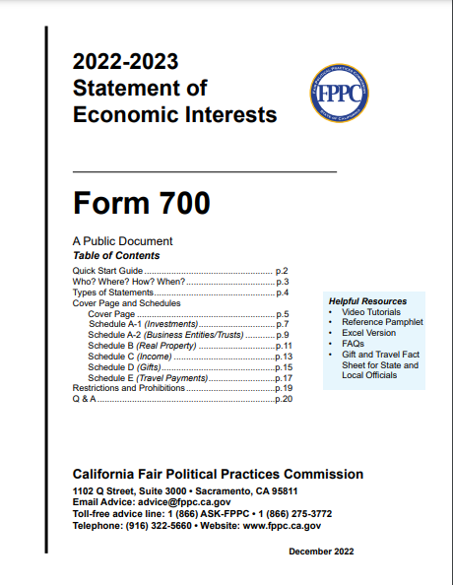
Statement of Economic Interests
(FPPC Form 700)
What is a Form 700 ?
  Form 700 is a public document intended to alert public officials and members of the public to the types of financial interests that may create conflicts of interests.
  Another name for Form 700 is Statement of Economic Interest

Slide 4
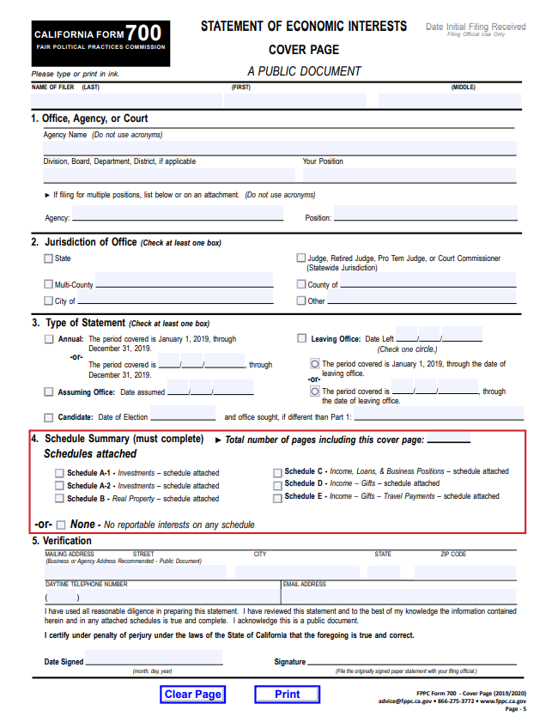
Statement of Economic Interests
(FPPC Form 700)
The cover page is always required (pictured right), even if you “have nothing to report”.
Each Section (1-5) should be completed accurately.
List your Last Name, First Name & Middle
Section 1 Agency Name is City of Oakland; Division/Board list the full name of your board/commission (no acronyms).
Section 2 Jurisdiction is City of Oakland
Section 3 Type of Statement depends on the filer’s timeline, see slide 5.
Section 4 Schedule Summary – review each schedule and the corresponding instructions, check the box of the schedule(s) that apply to you and total your pages OR check None – No reportable interest
Section 5 Verification – list up to date contact information, date your form and add your wet signature.

Slide 5
Statement of Economic Interests
(FPPC Form 700)
What Financial Interests Are Involved?
Financial Interest are disclosed within the applicable schedule(s) listed below
  Schedule A-1 : Investments
  Schedule A-2 : Business Entities/Trusts
  Schedule B : Oakland Rental Property
  Schedule C : Non-governmental salaries
  Schedule D : Gifts from public officials, businesses, vendors, or other contractors
  Schedule E : Travel payments or reimbursements made to you by someone other than your employer
  *see the back of each schedule for specific instructions on that particular schedule.

Slide 6
Did You Know That There Are Many Different Times You Are Required To File A
Form 700?
Types of Statements | Due Date
Assuming Office | Within 30 Days of Assuming Office Date
Annual Statement | April 1st Every Year (excluding weekends and holidays)
Leaving Office* | Within 30 Days of Resignation or Expiration of Term
Amendments | Immediately Upon Discovery Of Error
*contact the Office of the City Clerk with your Leaving Office Date

Slide 7
Statement of Economic Interests
(FPPC Form 700)
  How to File?
    File an electronic form via NetFile here: https://netfile.com/filer Please Note: new filers are not able to create their own account. The City Clerk’s Office will create the account.
    File a hardcopy with wet signature, by visiting https://www.oaklandca.gov/services/file-a-statement-of-economic-interest-form-700,
    Complete the form and mail or drop off to
    City of Oakland
    Office of the City Clerk
    ATTN: SEI
    1 Frank H. Ogawa Plaza
    Oakland, CA 94612
    PLEASE NOTE YOU CANNOT SUBMIT A SCAN OR COPY

Slide 8
Statement of Economic Interests
(FPPC Form 700)
Enforcement:
  Late statements are subject to a fine of $10 per day for each day the statement is late, up to $100.
  Failing to file can result in referral to the California Fair Political Practices Commission (FPPC), additional fines and possible prosecution.
  Failure to file may be cause for removal of an appointed member

Slide 9

QUESTIONS
  If you have questions related to Form 700
  Please contact Elections Services:
  electionservices@oaklandca.gov

